Slide 1
The Roman Empire
03.06.19

Slide 2
What is the Roman Empire?
The Roman Empire was the post-Roman Republic period of the ancient Roman civilization. Ruled by emperors, it had large territorial holdings around the Mediterranean Sea in Europe, North Africa, the Middle East, and the Caucasus. From the constitutional reforms of Augustus to the military anarchy of the third century, the Empire was a principate ruled from Italy, homeland of the Romans and metropole of the empire, with the city of Rome as capital. The Roman Empire was then ruled by multiple emperors and divided in a Western Roman Empire, based in Milan and later Ravenna, and an Eastern Roman Empire, based in Nicomedia and later Constantinople. Rome remained the nominal capital of both parts until 476 AD, when Odoacer deposed Romulus Augustus after capturing Ravenna and the Senate of Rome sent the imperial regalia to Constantinople. The fall of the Western Roman Empire to barbarian kings, along with the hellenization of the Eastern Roman Empire into the Byzantine Empire, is conventionally used to mark the end of Ancient Rome and the beginning of the Middle Ages.
The Roman Empire was established by Augustus in 27 BC.
It then divided by Theodosius in 395 AD into the Western or Latin and Eastern or Greek Empire.

Slide 3
The most popular rulers of Rome in the Roman Empire
General Pompey
Julius Caesar
Sulla
Mark Anthony
Octavian
Numa pompilius
Who else do you know is a famous ruler?

Slide 4
Why were rulers in Rome so important?
Rulers were SOO important because they had to maintain law and order.
They were also very important to give direction to their subject.
Rulers were a bit like Kings and Queens.
What do you think Roman life would be like with no rulers and a King and a Queen?
What do you think our life today would be like with rulers?

Slide 5
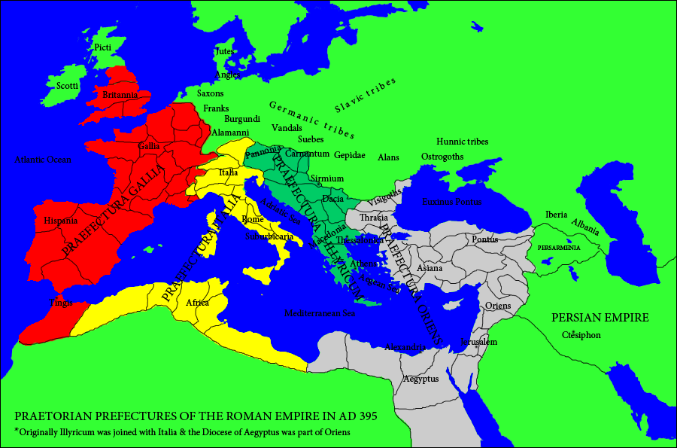
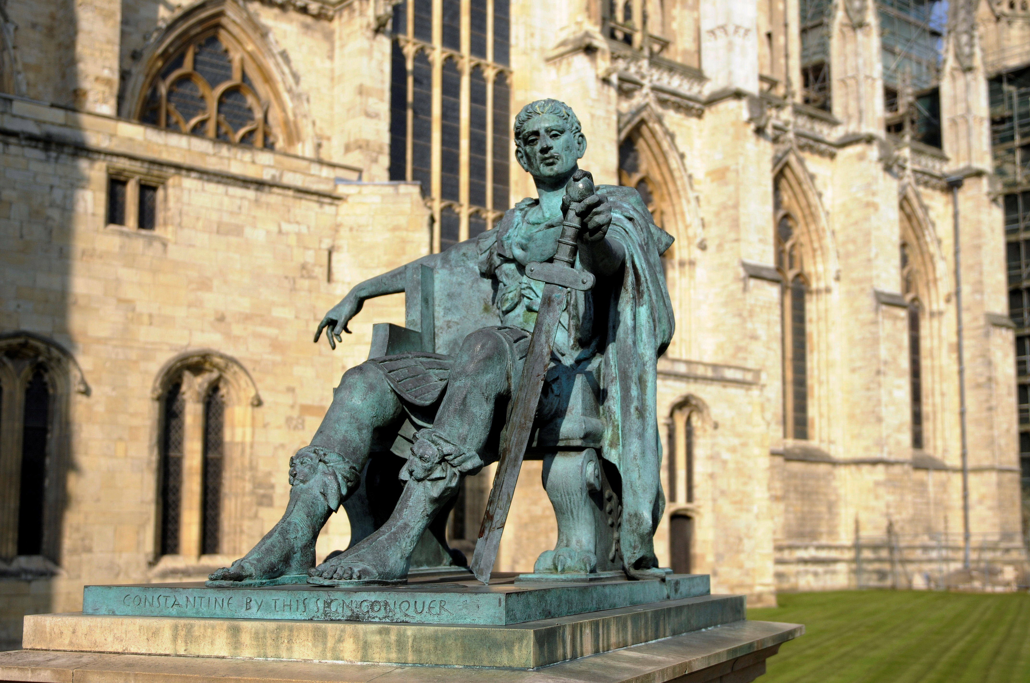
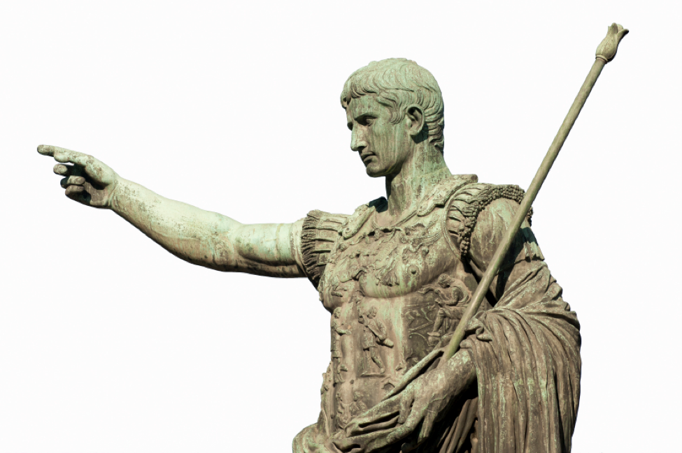
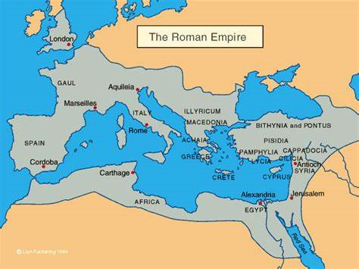
Images of the subjects that I’ve talked about
This is about the 1st subject that I talked about: what is the Roman empire? Here are some images of the Roman Empire:
Here are some pictures of rulers in Rome:

Slide 6
I hoped you liked my power point presentation
I hope you all liked my power point presentation and I will be sending some more documents on word.
If you have more knowledge in your brain about the romans I would love to hear it.
AND AGAIN I HOPE YOU ENJOYED MY POWER POINT PRESENTATION!

