Slide 1
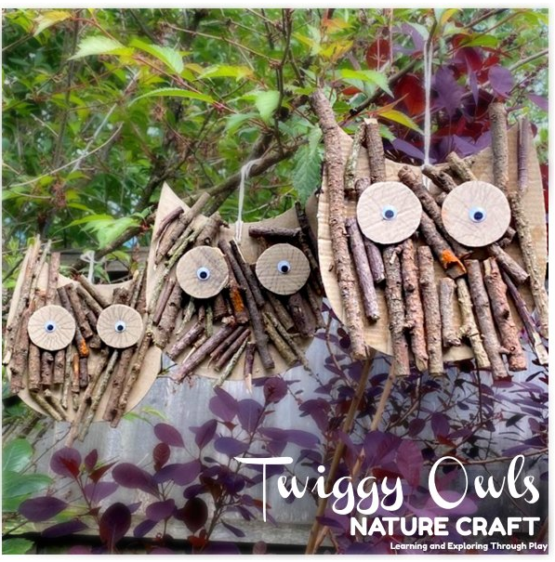
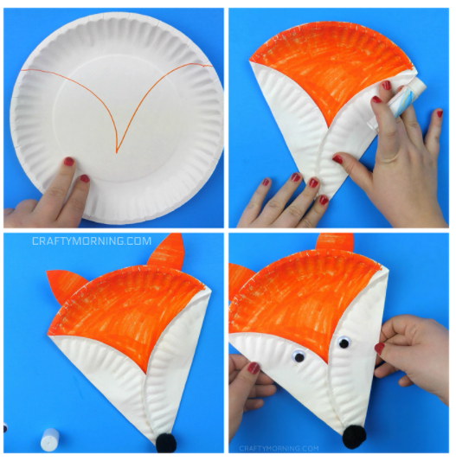
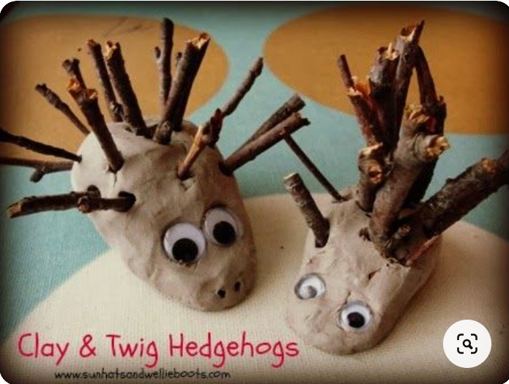
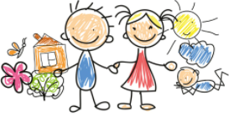
Add photos or videos to Tapestry to show us your work!
My Home Learning Journey Grid:
Week beginning: Monday 1st February
This weeks focus is Percy the Park Keeper and woodland animals.
MATHS:
Have a numeral hunt around the house. Choose a number between 0 and 5, then hide post-it’s with the same number all over the house. How many ‘fours’ can you find? Repeat with a different numeral each day.
READING + COMMUNICATION AND LANGUAGE:
This week we are going to be reading two ‘Percy the Park Keeper’ stories.
Listen to /watch the Percy Park Keeper story ‘Treasure Island’ https://www.youtube.com/watch?v=hGYHCpMhd7s
Hide some ‘treasure’ in your house or garden and draw a treasure map to find it. I am going to hide some gold chocolate eggs around the school willow garden for us to find.
Listen to /watch the Percy Park Keeper story ‘The rabbit who was afraid of the dark’ https://www.youtube.com/watch?v=u8O4ZaAIMNg
Think about all the different feelings we have. Rabbit was frightened – show a frightened face. What other feelings do we have? Show them on your face and see if your family can guess how you are feeling....grumpy, cross, happy, silly, shy etc.
Also, can you complete the finding the woodland animal poster and discuss the animals using the questions.
EXPRESSIVE ARTS AND DESIGN:
Let’s get creative!
Can you make a fox just like the fox in Percy the Park Keeper?
Can you make hedgehog just like Holly the Hedgehog in our maths task- you can use clay/playdough and twigs.
Can you make a twig owl to hang? You could collect some twigs when you are out on your daily walk.
Education City Tasks:
Sizing up
Stop, Pop and Listen
Same Difference
ABC, sing along
MATHS:
Size ordering. Can you order the woodland animals from Percy’s story. Which animal is the biggest and which is the smallest? Can you also complete Holly Hedgehogs nature trail powerpoint?
WRITING:
This week we are going to be using our name cards to practice writing our name. Please practice this at home too.
Makaton: This weeks signs are ‘Yes and No.’
PHYSICAL DEVELOPMENT:
Use play dough to strengthen fine motor muscles. Watch this short video to learn moves to exercise the hands and fingers. I have included a recipe to make playdough on the slide below.
Dough dance/finger gym routine | Down in the Jungle | Nursery rhyme with playdough – YouTube
PHONICS- Please find on one of the following slides an activity to complete, to support the development of Phase 1 phonics.

Slide 2
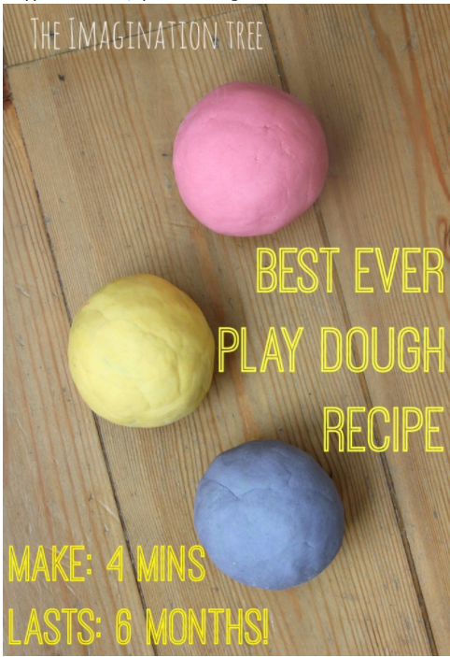
Play Dough Recipe
Here is a recipe to make the best ever, no cook play dough recipe. It will last for 6 months!
You will need:
2 cups of flour
2 tablespoons vegetable oil (baby oil and coconut oil work too)
1/2 cup salt
2 tablespoons cream of tartar
1 to 1.5 cups boiling water (adding in increments until it feels just right)
gel food colouring (if you want colourful playdough)
few drops glycerine (optional)
Method:
Mix the flour, salt, cream of tartar and oil in a large mixing bowl.
Add food colouring TO the boiling water then into the dry ingredients.
Stir continuously until it becomes a sticky, combined dough.
Allow it to cool down then take it out of the bowl and knead it vigorously for a couple of minutes until all of the stickiness has gone. * This is the most important part of the process, so keep at it until it’s the perfect consistency!*
If it remains a little sticky then add a touch more flour until just right.
Best Ever No-Cook Play Dough Recipe! - The Imagination Tree
Making play dough is a great opportunity to learn about language, science and maths. It is a shared experience. Start off by exploring the different ingredients. Do they have the same texture, same colour etc? What happens when you add the flour and salt together? Is it dry or wet? What happens when you add in the water? Encourage your child to make observations about the changes throughout the process. Once they have started stirring you can talk about the texture. How does it feel? Is it sticky? This is an early learning opportunity about properties and ingredients.

Slide 3
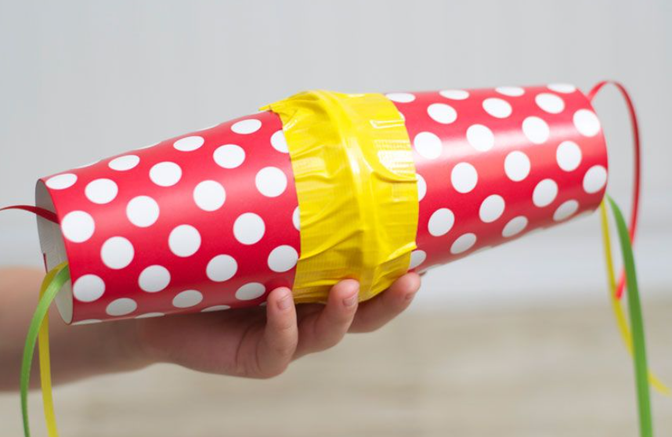
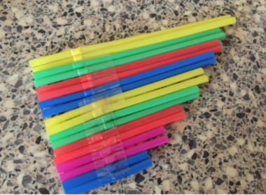
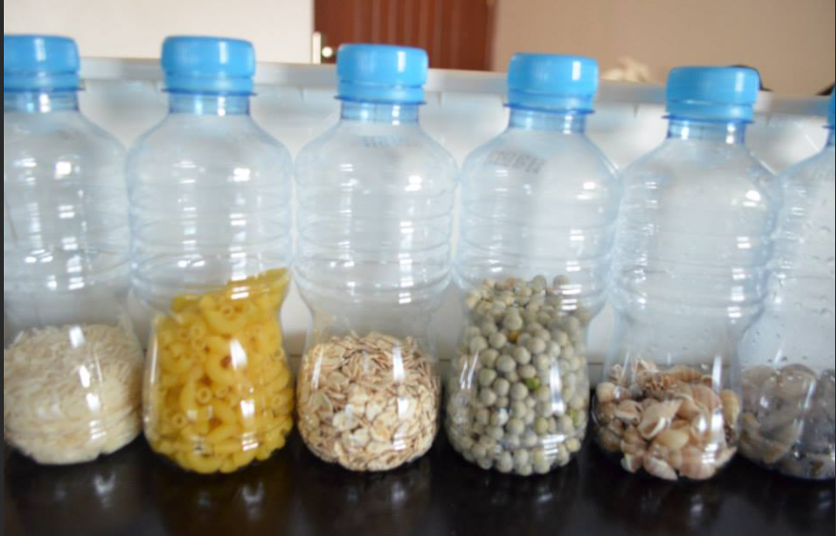
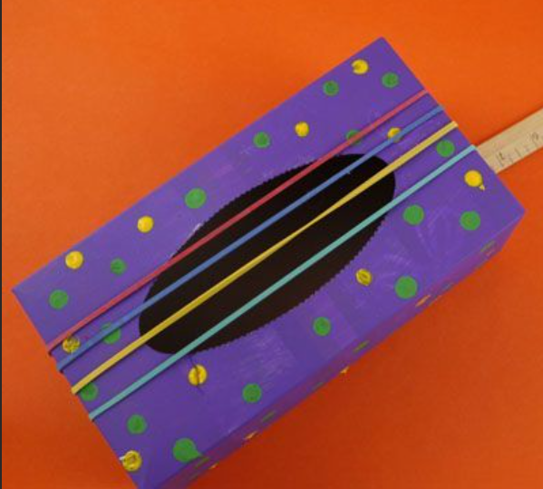
Phonics:
PHONICS + EXPRESSIVE ARTS AND DESIGN:
Can you make your own musical instrument. For example, using a bottle and filling it with rice, peas, pasta, stones, beads etc.
Think about playing your instrument fast and slow and loud and quiet.

Slide 4
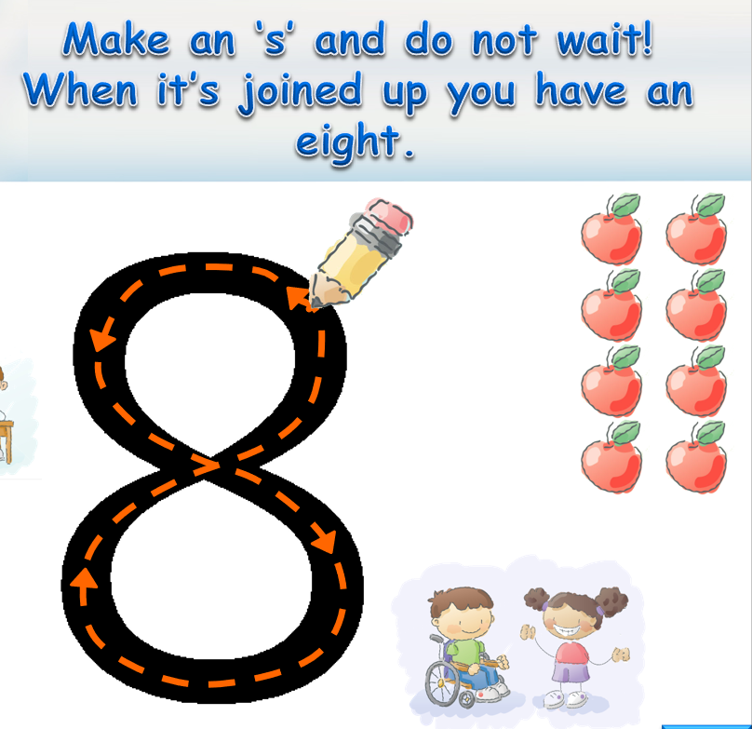
MATHS: Exploring the numbers 7 and 8
Learn the number rhymes for number 7 and number 8. Use your magic finger and trace them in the air. You can then practice writing them as well as an extra challenge.
Math's Number Rhymes:

Slide 5
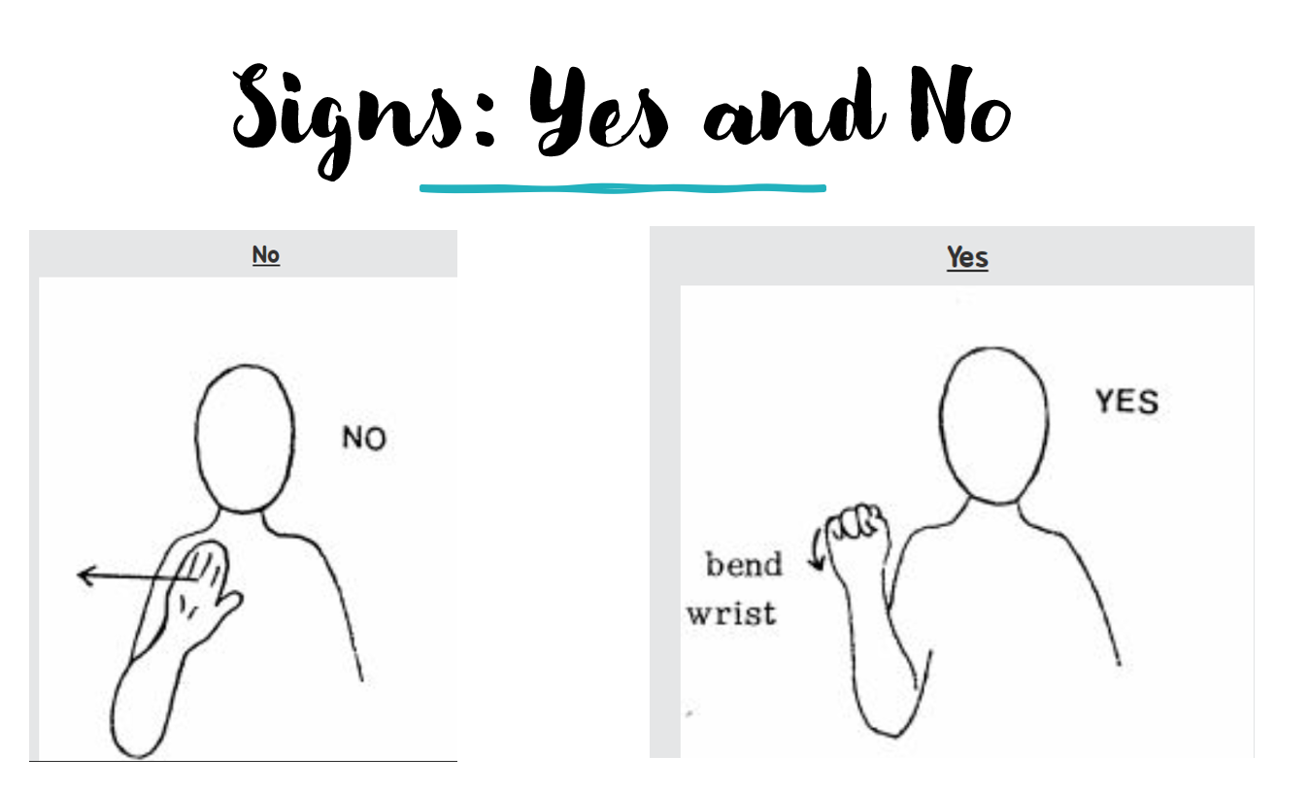
Makaton Signs of the week:

