Slide 1
W.A.L.T. Read and write poems about Easter.
W.I.L.F.
You can be a text detective, to find out what a poem is about;
You can find the features of a good poem;
You can write a poem to put into your Easter card.

Slide 2
Task 1
Carefully read the poem on the next slide and answer these questions:
What is the poem about?
Write down 1 or 2 pairs of words that rhyme;
Challenge!
Clap quietly as you read the poem again. Write down the words that you clap on (this is called the metre in poetry)

Slide 3
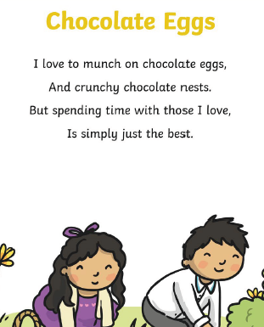

Slide 4
Task 2
Carefully read, or ask a grown-up to read to you, the poem on the next slide and answer these questions again:
What is the poem about?
Write down 1 or 2 pairs of words that rhyme;
Challenge!
Clap quietly as you read the poem again. Write down the words that you clap on (this is called the metre in poetry)
Both of these poems use iambic metre, which we can march to:
i AM i AM i AM i AM That’s how you remember Iambic.

Slide 5
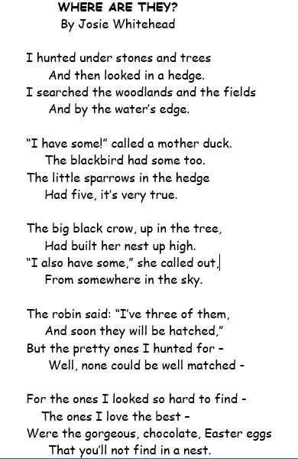

Slide 6
What could we include in a successful poem?

Slide 7
Task 3
Choose either an acrostic poem, senses poem or a shape poem, and write a first draft today;
Tomorrow, you will edit and write a final draft;
There are writing frames for each poem type on the next few slides, if you would like to use them.

Slide 8
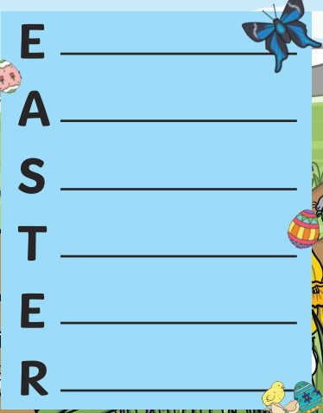

Slide 9
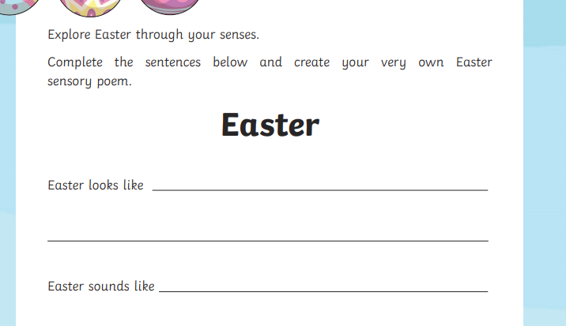

Slide 11
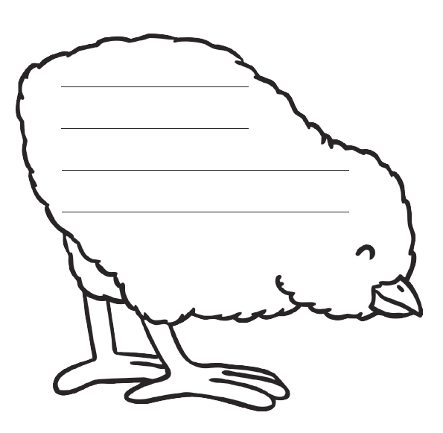

Slide 12
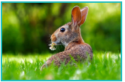
Optional Task for Thursday or Friday
Joyously
Without hesitation
In the blink of an eye
In the distance
Later that day
Feeling excited

Slide 13
Friday
W.A.L.T.
Produce a final draft of your poem.
W.I.L.F.
You can proofread and edit your poem;
You can use your best handwriting and presentation skills.

Slide 14
Task 1
Read through your poem from yesterday.
In a different pen/pencil, correct;
Missing punctuation;
Spellings – use a dictionary;
Then:
- Improve any words or lines that you are not happy with;
Change the order of your lines, if you want to.

Slide 15
Task 2
Use a new piece of paper:
Write the title of your poem (no date needed!) and write a final draft of your poem, adding in your improvements;
Illustrate your poem, using coloured pencils.
Remember: If you are doing a shape poem, you will need to trace the outline of your shape first!

Slide 16
Task 3
Read your poem to a grown-up. What do they like about your poem? Which is their favourite line? You could learn your poem and share a video of you reciting it on dojo, if you like!

