Slide 1
Monday, 25 January 2021
Good morning everyone!
- Get your drawer
- Put your reading record in your drawer
- How fast can you complete your five
times table matching cards activity
Everything is difficult before it is easy
Now we are all settled, let’s listen to a story…
https://www.bbc.co.uk/teach/school-radio/audio-stories-the-crow-and-the-peacock/zmggy9q

Slide 2
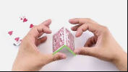
My Home Learning Grid
Week beginning - 1.2.2021
Don’t forget to say hello on
Class Dojo!
Task 1 – Reading Aloud
I feel like we have all heard quite enough of Mrs Dixon’s voice and so I would like to hand story time over to you…
Choose a picture book from home and practise reading it aloud until you feel confident. Then ask your grown up to record a video of you telling your story to share with the class.
Everything is difficult before it is easy
This week is Children’s Mental Health Week and it feels like an important time to tell you that I am very, very proud of how you are doing during this Lock Down.
I hope you are enjoying the home learning jobs I send you each week but please don’t worry if you aren’t able to do them. The most important thing is that you are happy and safe.
The mini Dixons seem to be enjoying home school (but they have to say that) and I hope you are too. Although I will be VERY glad when we are all together at school again.
Maths – Money
Lesson 1: Revisiting the value of coins: Comparing value
https://classroom.thenational.academy/lessons/revisiting-the-value-of-coins-comparing-value-74rkcr
Lesson 2: Coins and notes
https://classroom.thenational.academy/lessons/coins-and-notes-6wup4t
Lesson 3: Counting money in a set of coins
https://classroom.thenational.academy/lessons/counting-money-in-a-set-of-coins-65h32d
Lesson 4: Revisiting the value of coins
https://classroom.thenational.academy/lessons/revisiting-the-value-of-coins-65jp2r
Lesson 5: Change from a pound
https://classroom.thenational.academy/lessons/change-from-a-pound-6wwkac
Task 2 – Patience
I would like you to build a house of cards…
I am giving you a fiddly job to do to encourage you to be patient and to develop resilience because it might take a little while to get this skill.
Task 4 – Power of Positive Thinking
If we tell ourselves we cannot do something then it becomes impossible.
Work with a grown up at home to complete the Positive Power activity. I bet you have more strengths than you even realise!
Task 3 – Practise makes Progress
Look again at the tasks I set in week one. Can you can write your full name and address without any help? Have you completed your 2, 5, 10 x table diploma? Don’t give up!
Task 5 - Debugging
Writing code is a perfect activity for developing patience. We often need to find and fix errors in our code – this is called “debugging”.
https://hourofcode.com/moana
Keeping in Touch
Join in with Draw with Rob on Friday pm
Look for #18 Unicorn online
https://youtu.be/YWc5JVDGKAA
Notes:
https://teachers.thenational.academy/units/faces-shapes-and-patterns-lines-and-turns-1338

Slide 3
Stage: 2 | Spelling Rules: The /l/ or /ul/ sound spelled ’-le’ at the end of words.
Spellings | 1st Attempt | 2nd Attempt | 3rd Attempt
table
apple
bottle
little
middle
bubble
cable
uncle
ankle
eagle

Slide 4
Write the correct spelling into each sentence.
1. The dinner hall had a ___________ missing.
2. The pencil pot was in the _____________ of the table.
3. The __________ mouse poked his nose out of the hole.
4. He tied up the boat with a big ___________.
5. My __________ takes me fossil hunting.
6. I knocked over the ___________ of_____________ juice.
7. Lewis fell playing football and broke his ____________.
8. My favourite bird is an ____________.
9. I filled the water with ___________ bath.

Slide 5
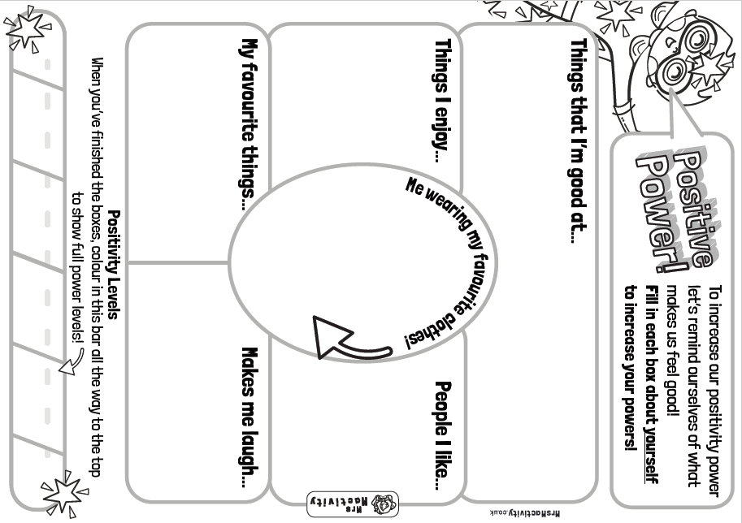

Slide 7
t
a
b
l
e
Spelling Rules: The /l/ or /ul/ sound spelled ’-le’ at the end of words.
Can you create a wordsearch full of your spelling words?
table
apple
bottle
little
middle
bubble
cable
uncle
ankle
eagle

Slide 8
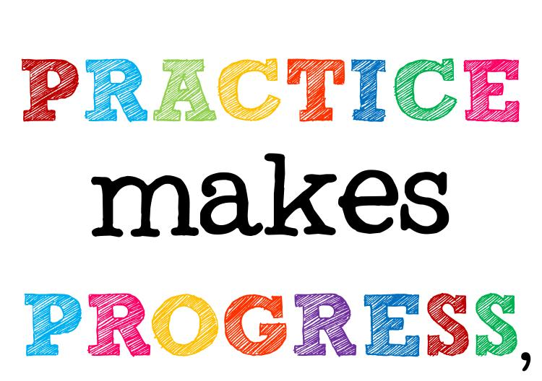
Keeping your learning in the fast lane with Y2
On-Track Targets
I set these tasks in Week 1 of Lockdown.
Continue to work on these things every week.
They are key skills which need regular practise to make progress.
Task 1
I can write my full name and address without any help.
Task 2
I can write each of my high frequency spelling words in a simple sentence that has a capital letter and a full stop.
Task 4
I can count in multiples of 2, 3, 5 and 10 from any number up to 100.
Task 3
I can read aloud from my school reading book* in a voice that is exciting for another person to listen to.
*or equivalently challenging book
Task 5
I can name the months of the year, put them in order and describe the typical British weather in each month.
http://www.seatonsluicesouth.northumberland.sch.uk/website/year_2/
Sounds and Words
I can read all 43 speech sounds and I can spell the 100 most common words in English.
Keeping in Touch
Log on to our Class Dojo page and pop a like or two on the posts you think are super.

Slide 9
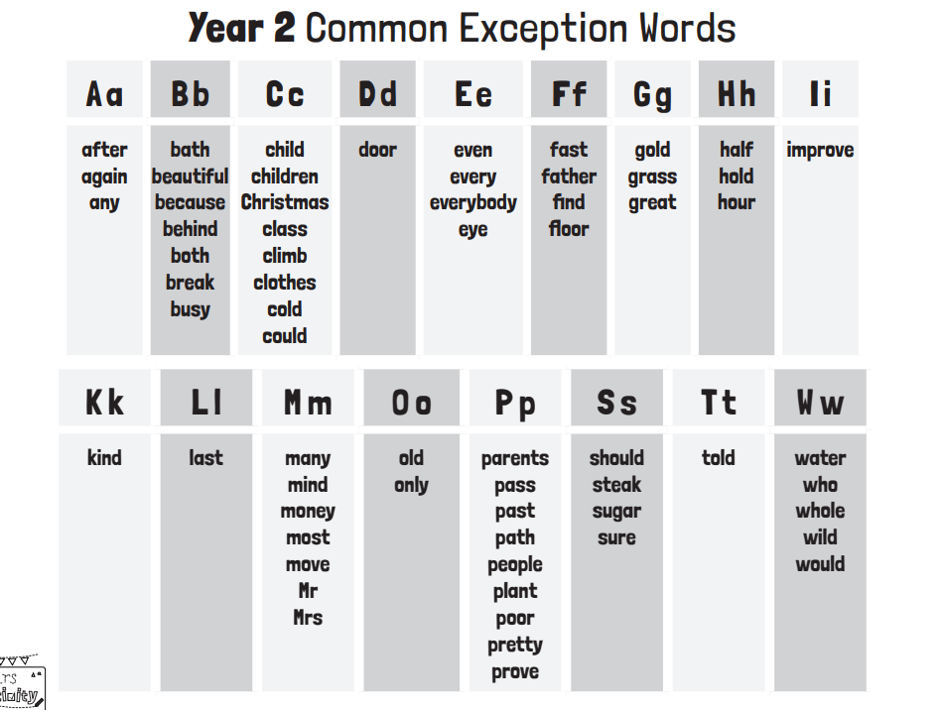
For Reference

Slide 10
For Reference

