Slide 1
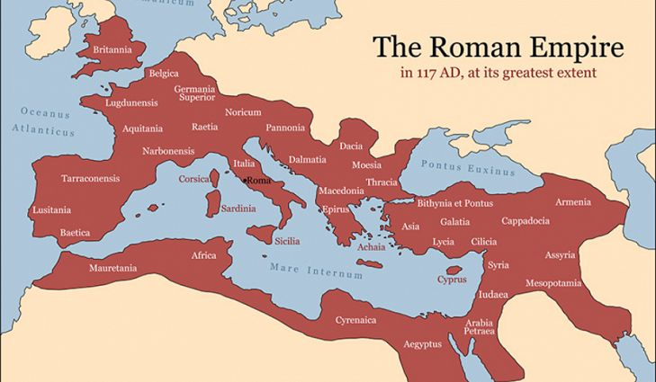

Slide 2
Introduction

Slide 3
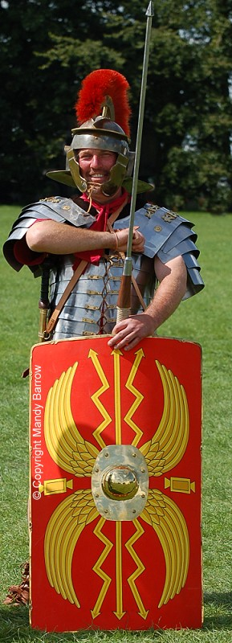
The Romans came to Britain nearly 2000 years ago and changed our country. Even today, evidence of the Romans being here, can be seen in the ruins of Roman buildings, forts, roads, and baths can be found all over Britain.
For my homework project I visited Segedunum Roman Fort & Museum and had a nights stay at a camp site along Hadrians wall walk, so I could explore some of the wall and see the ruins that I was going to learn about. It is hard to believe how old the ruins are.

Slide 4
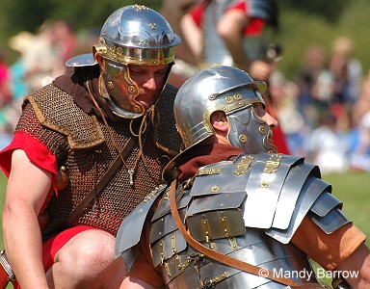
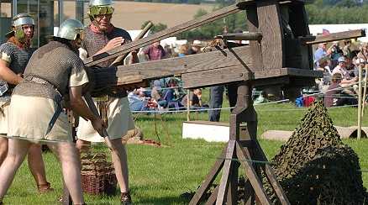
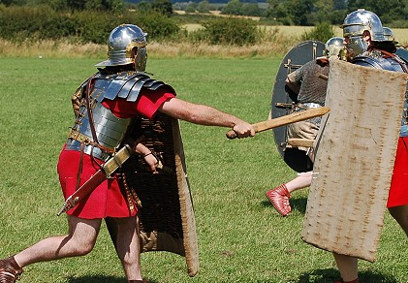

Slide 5
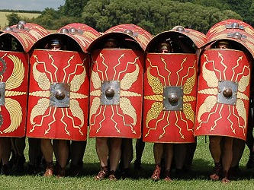
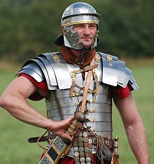

Slide 6
Segedunum

Slide 7
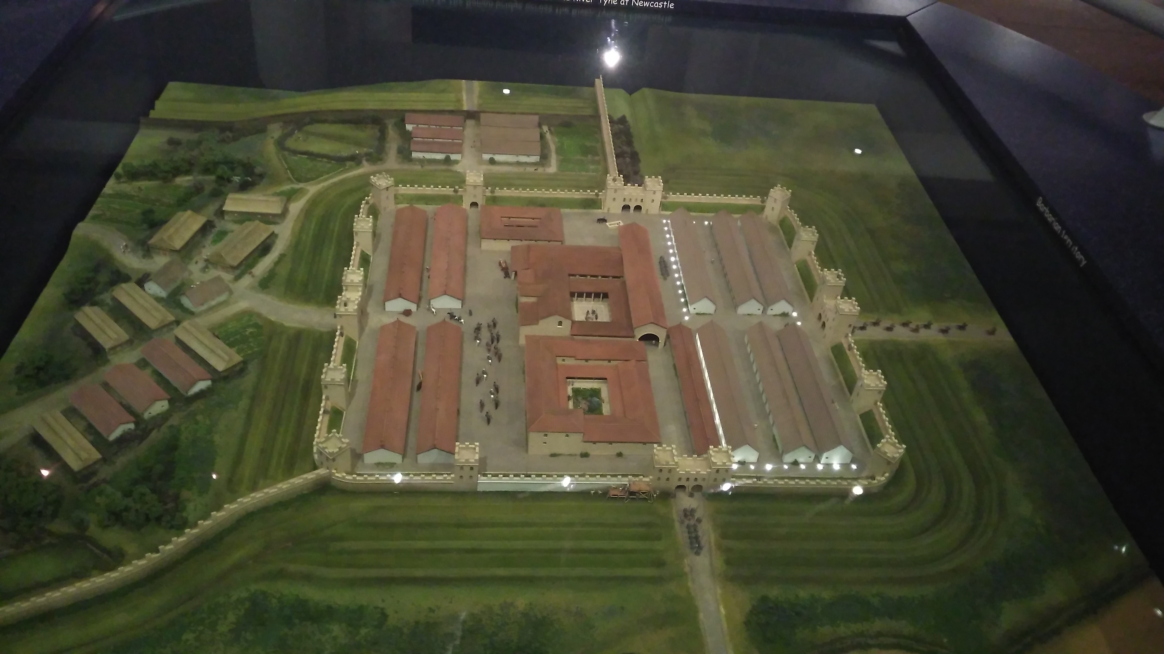
During the half term I visited the Segedundum Roman Fort & Museum in Wallsend, to learn more about the Romans.
I learnt a lot and I took lots of pictures!

Slide 8
Roman Clothing

Slide 9
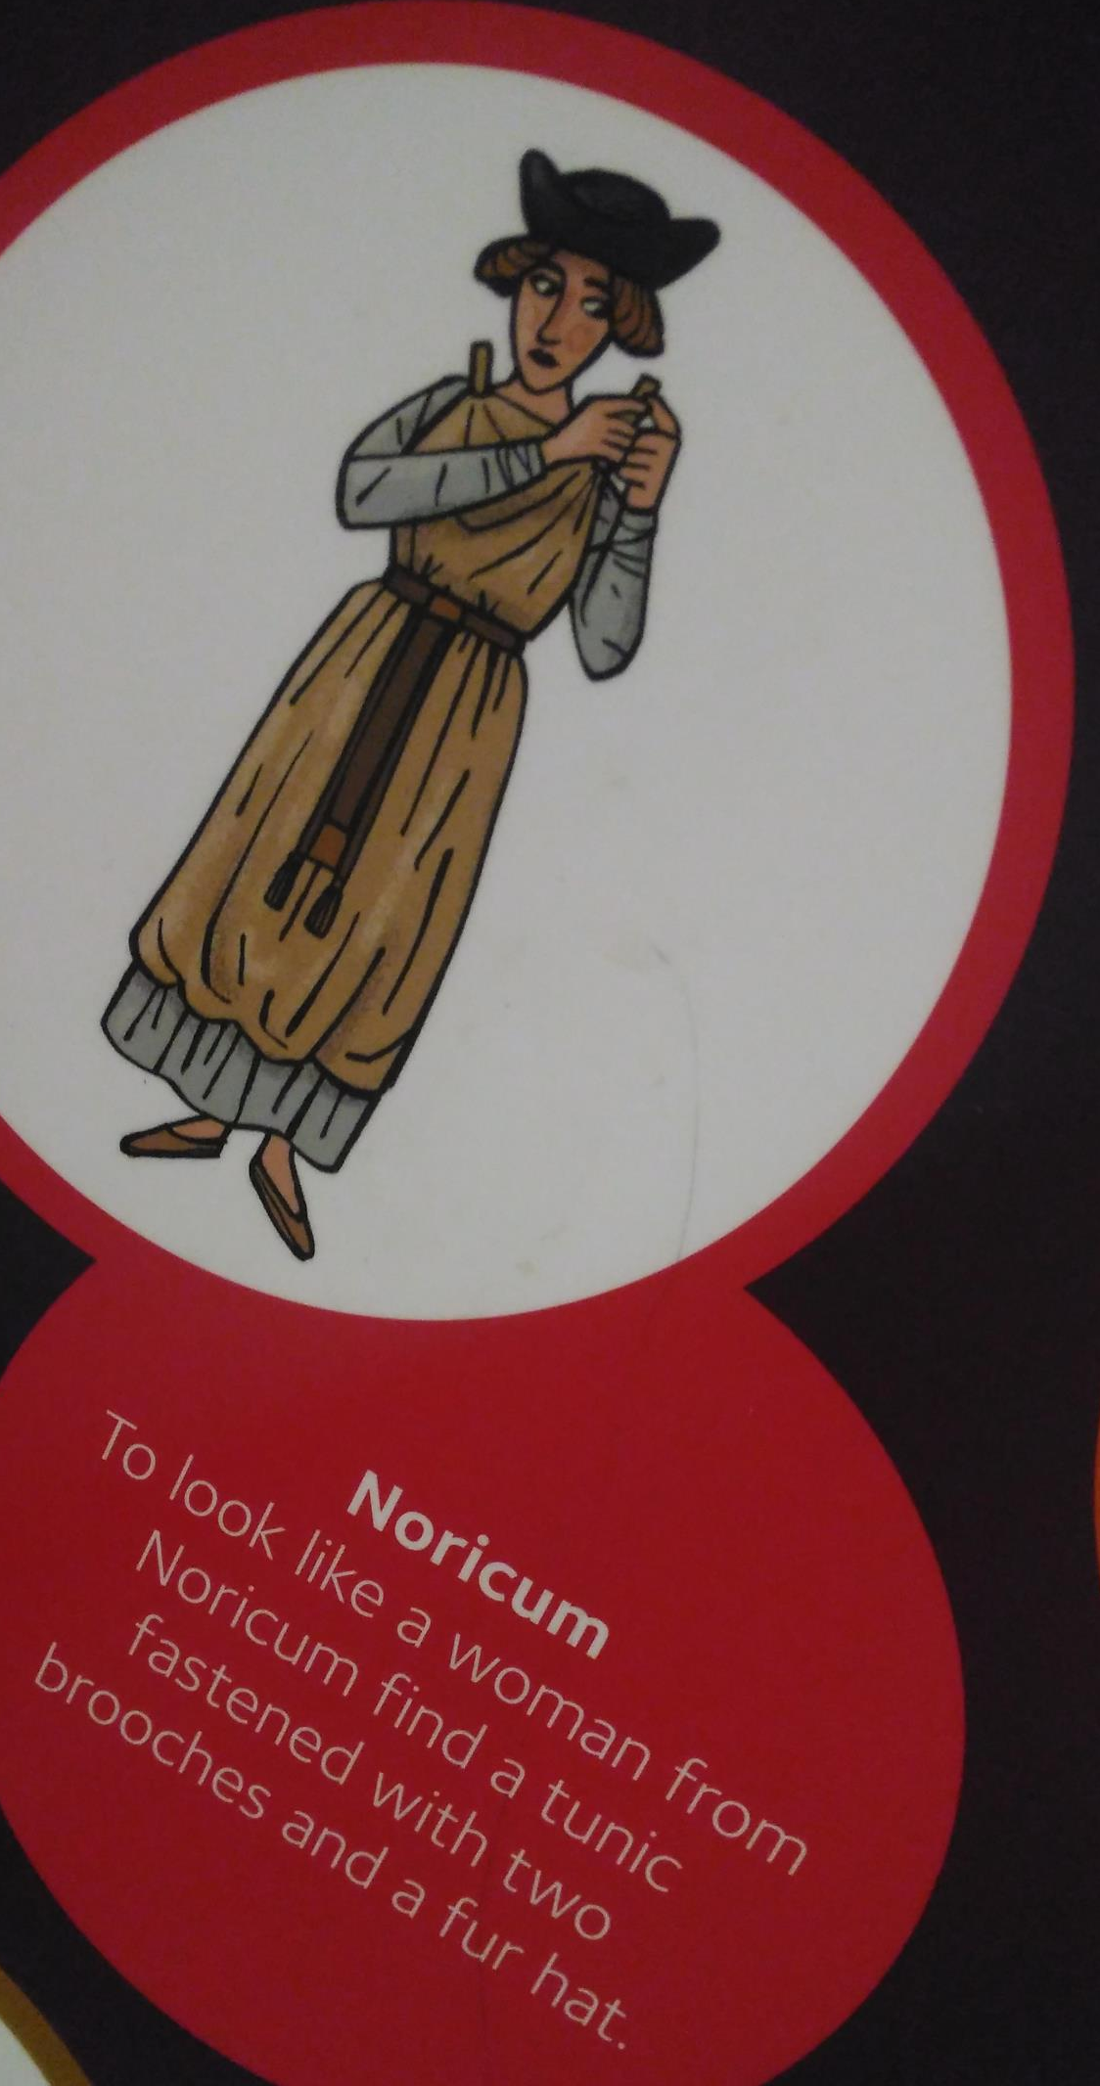
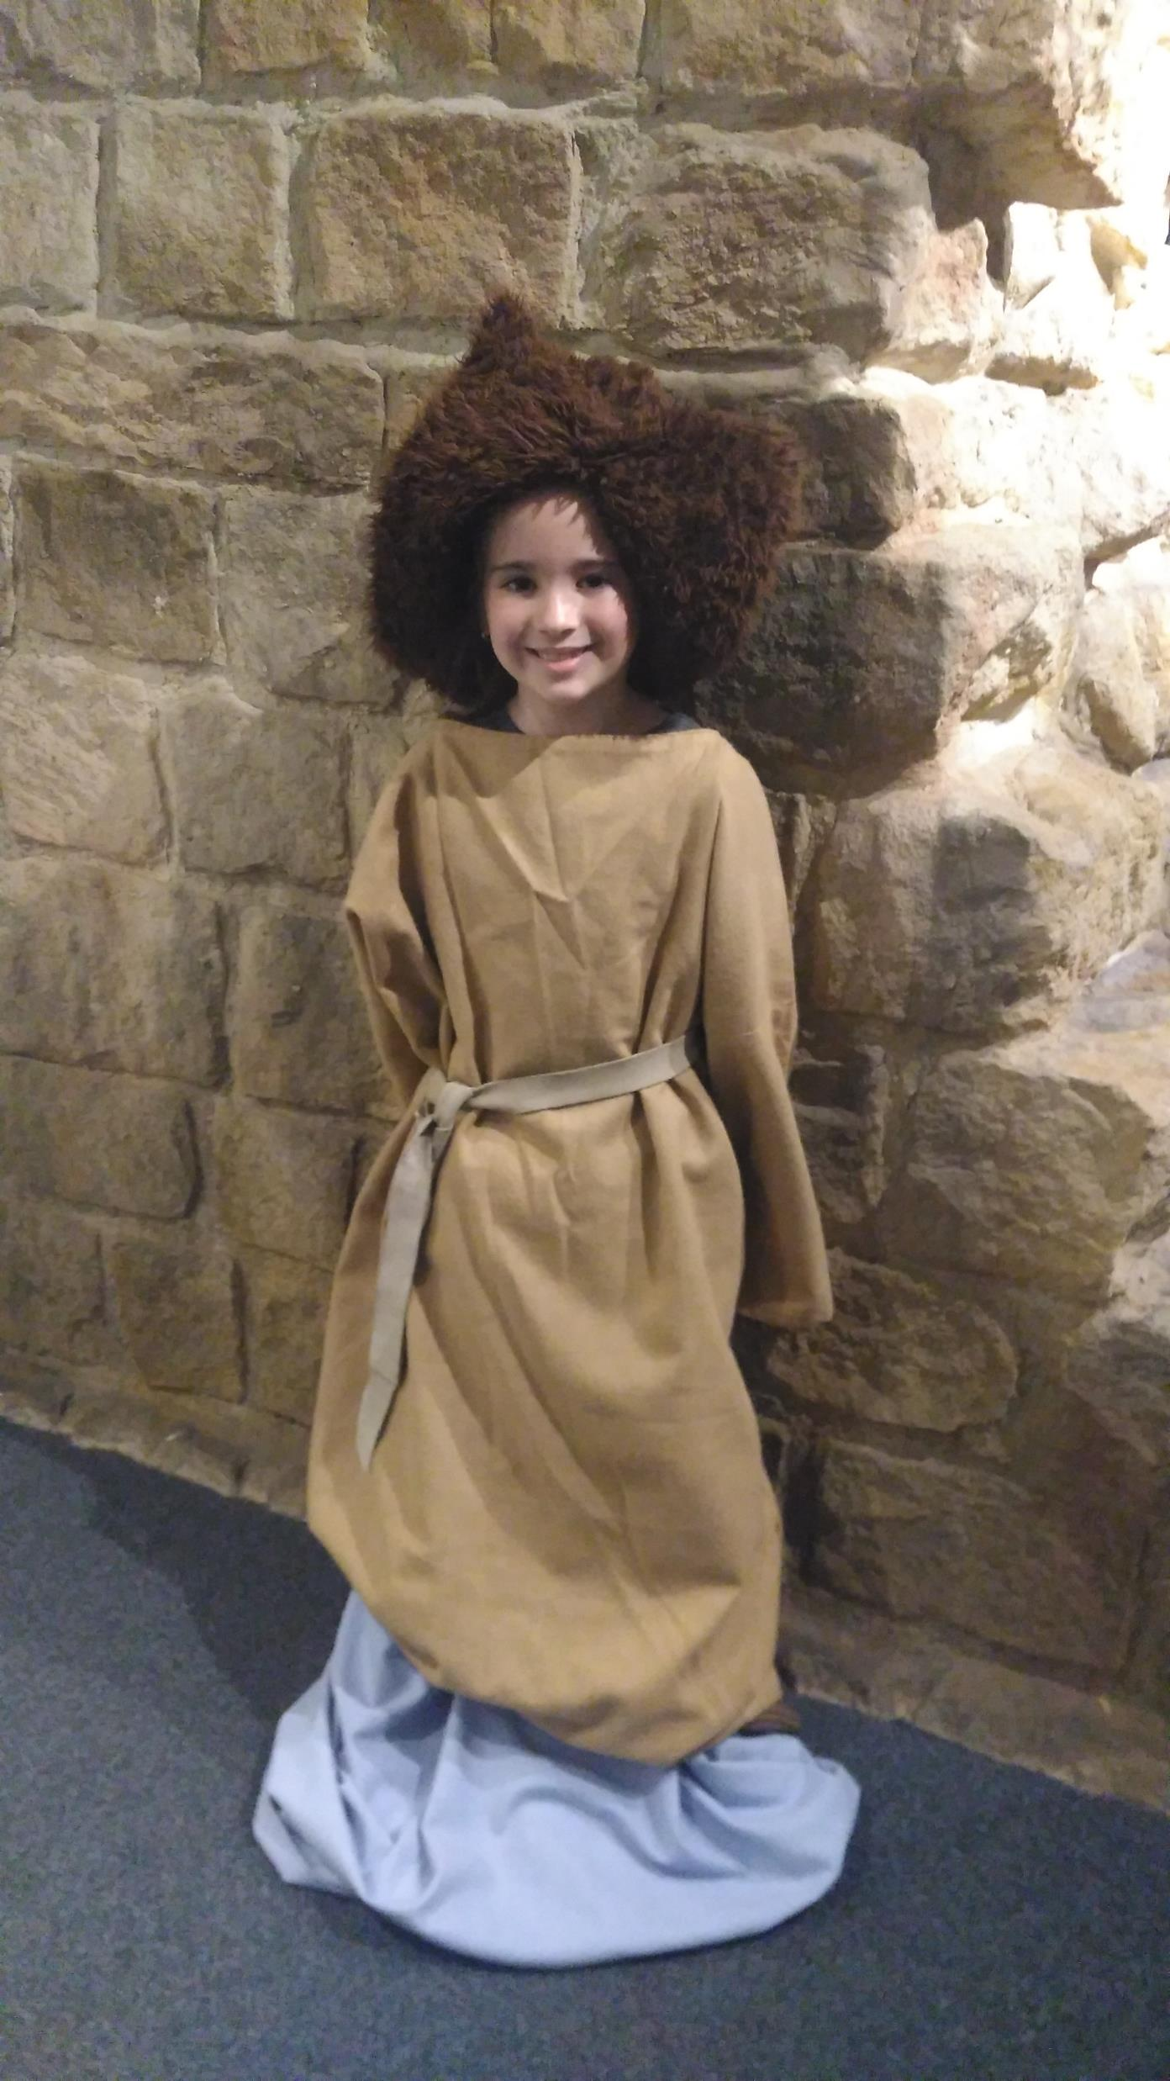
Dressing up as a Roman!
Using the descriptions in the museum, I chose the right clothes needed to dress up as lady from the early Roman times.
During the early Roman Empire many people continued to wear the traditional clothing of their native countries. Later on these were replaced by Empire-wide fashions.

Slide 10
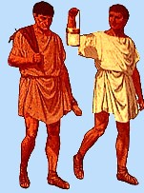
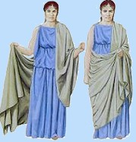
Roman Clothing
Men wore a knee-length tunic (chilton), either sleeveless or short-sleeved. Roman men wore a cloak over their tunic, which was like a wide shawl that was draped over the shoulder and carefully wrapped around the body.
Women wore a longer tunic which was often ankle-length. Over this the women wore a stola which was a full length from neck to ankle, high- waisted and fastened at the shoulders with clasps.
Boys wore a tunic down to their knees and a cloak if it was cold. Rich boy's wore a toga which had a purple border.
Girls wore a tunic with a woolen belt tied around their waists.
Children wore a special charm around their neck called a bulla. It was given to them when they were a few days old.

Slide 11
Roman Food & Drink

Slide 12
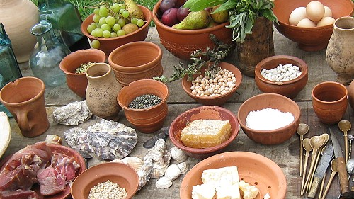
The Romans ate the fruit and vegetables, that they could grow. They also used cereals to make bread and ate a lot of meat. The Romans brought different food from other countries, like cabbage, cucumbers, radishes and broad beans. They used big jugs to drink wine and water.

Slide 13
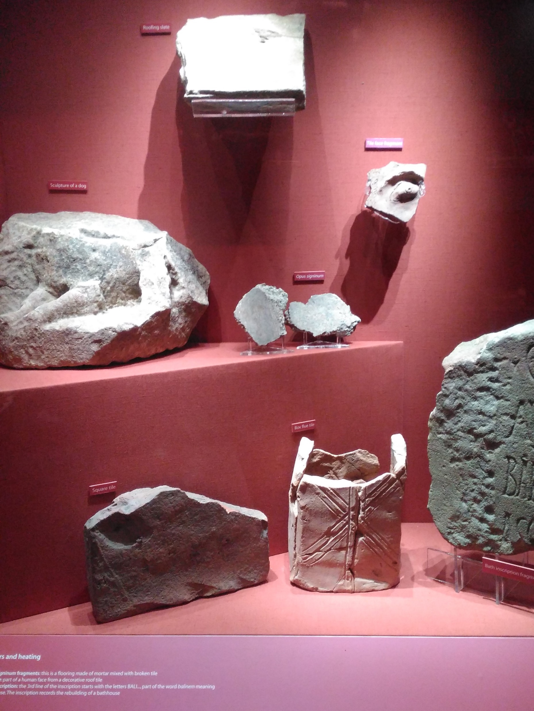
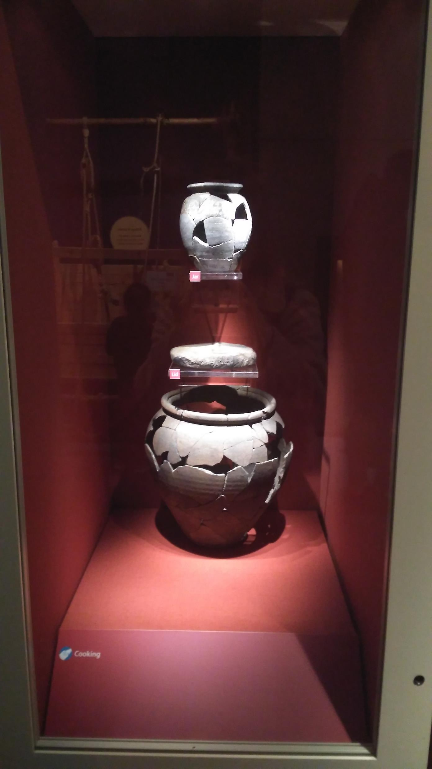
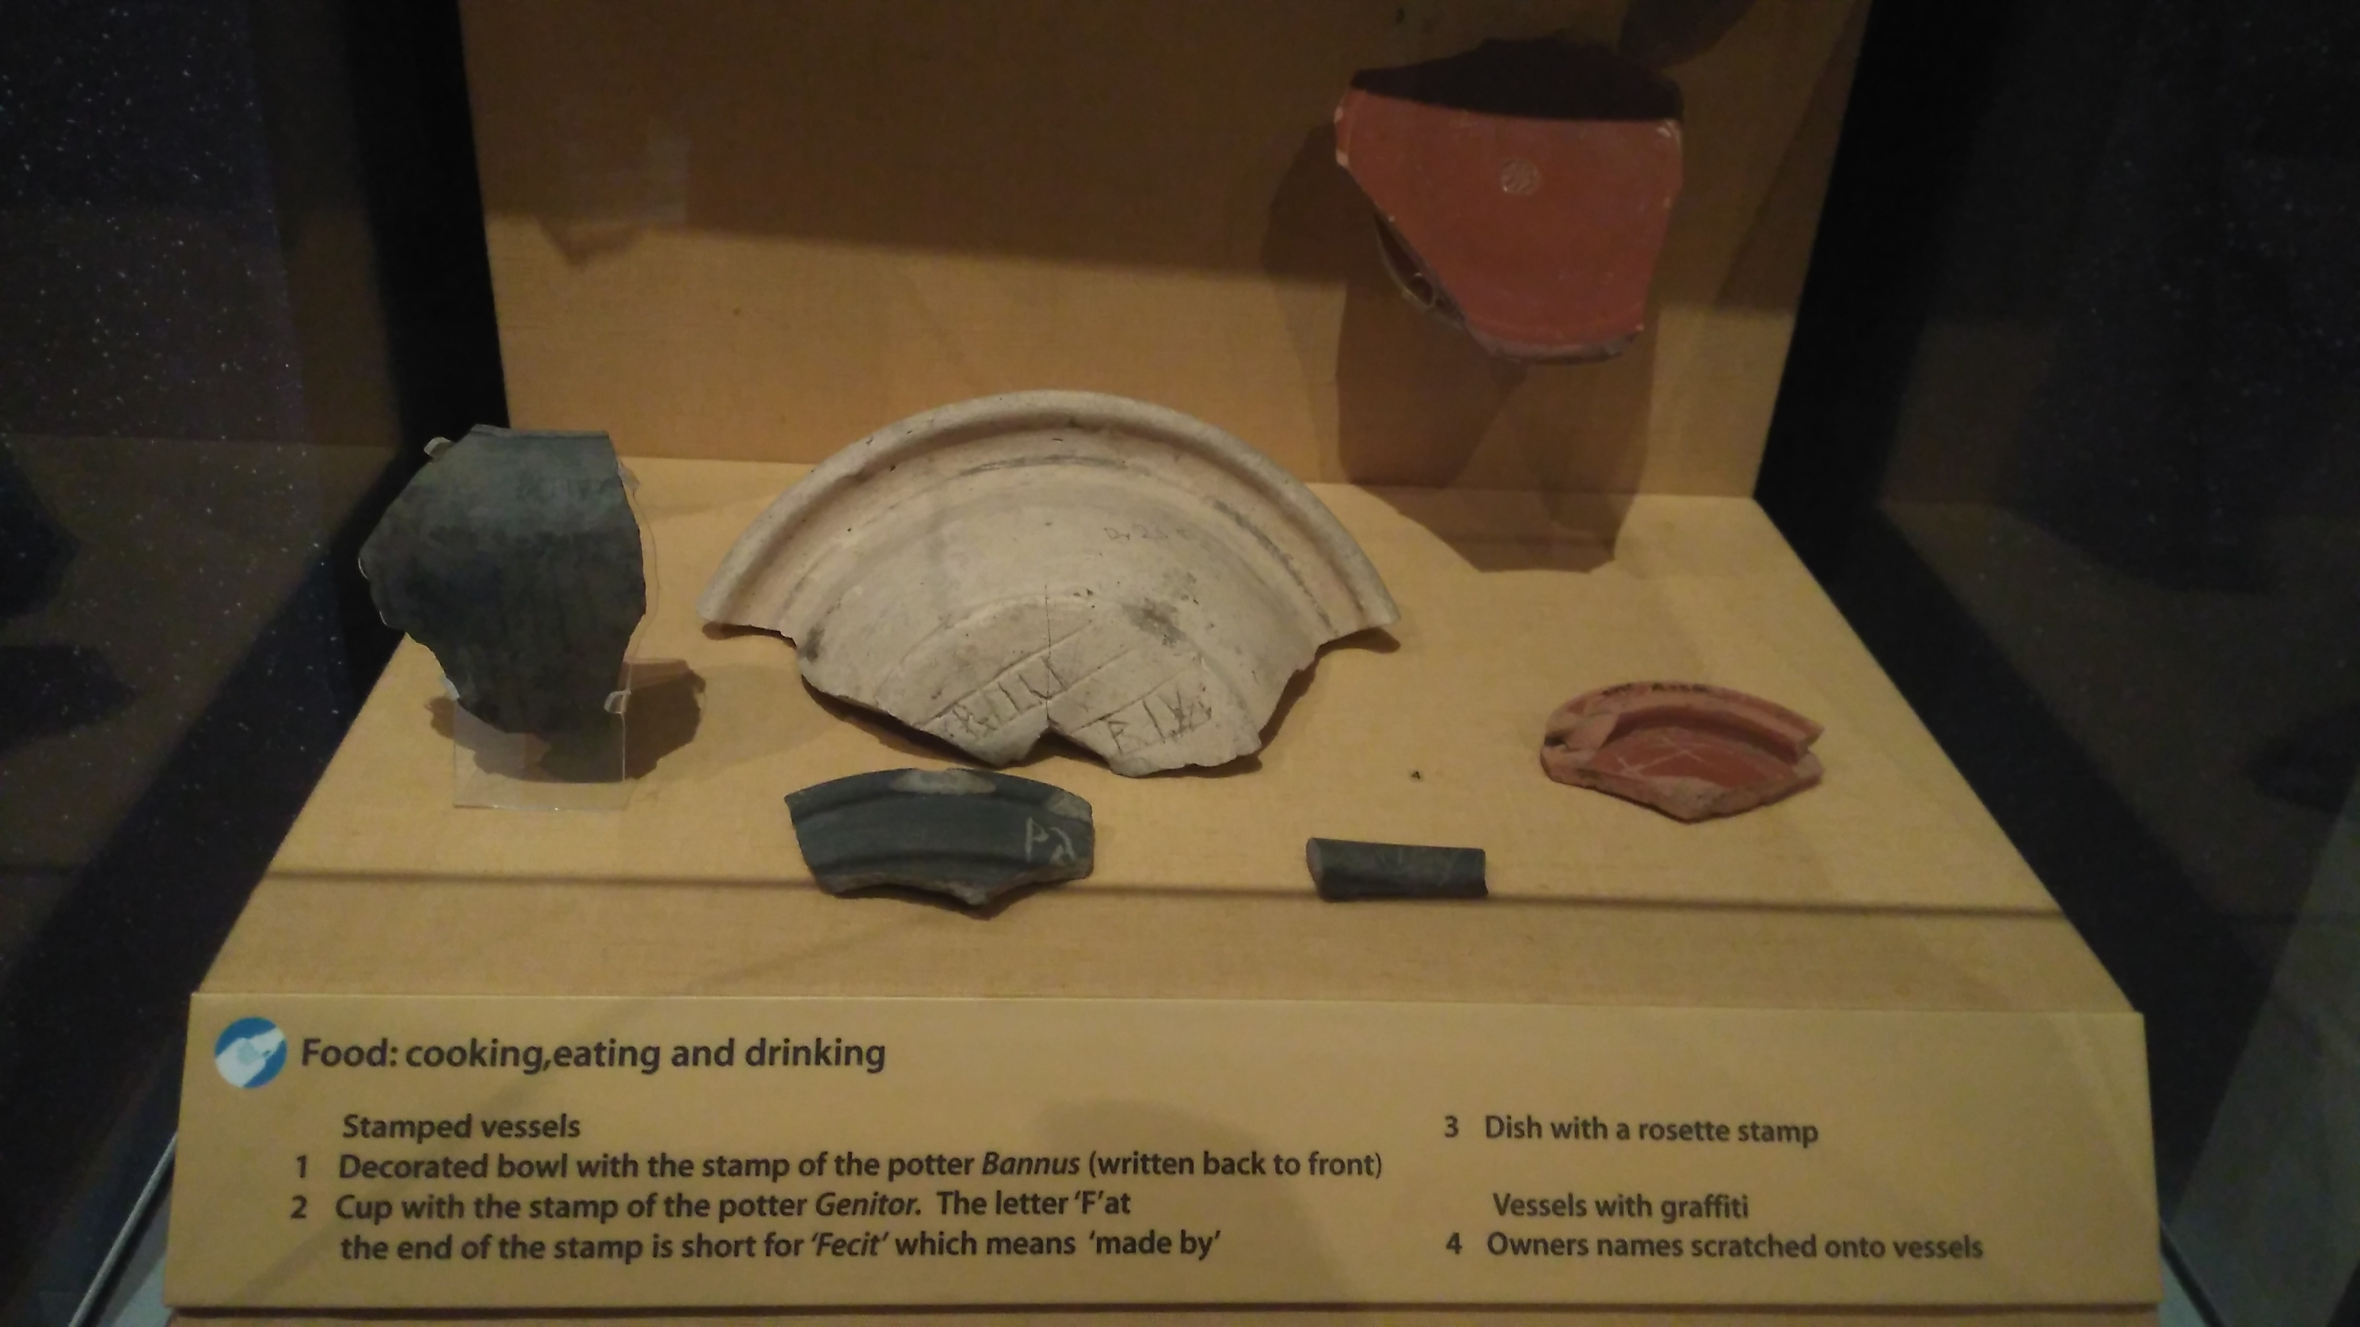

Slide 14
Roman Soldiers

Slide 15
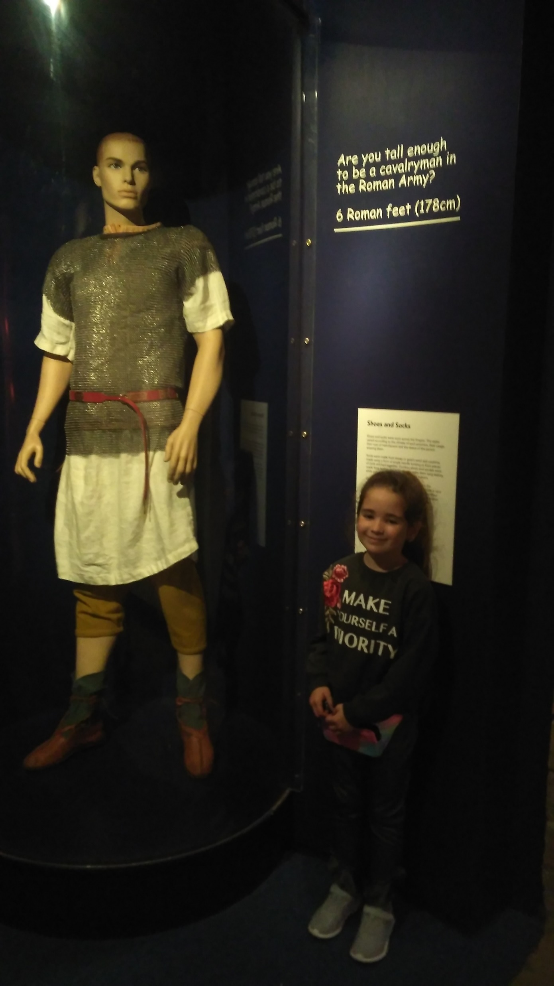
How tall do you have to be to be a Roman soldier?
You have to be 6 Roman feet tall, this is 178cm tall.
I was no where near tall enough, but my dad was close!

Slide 16
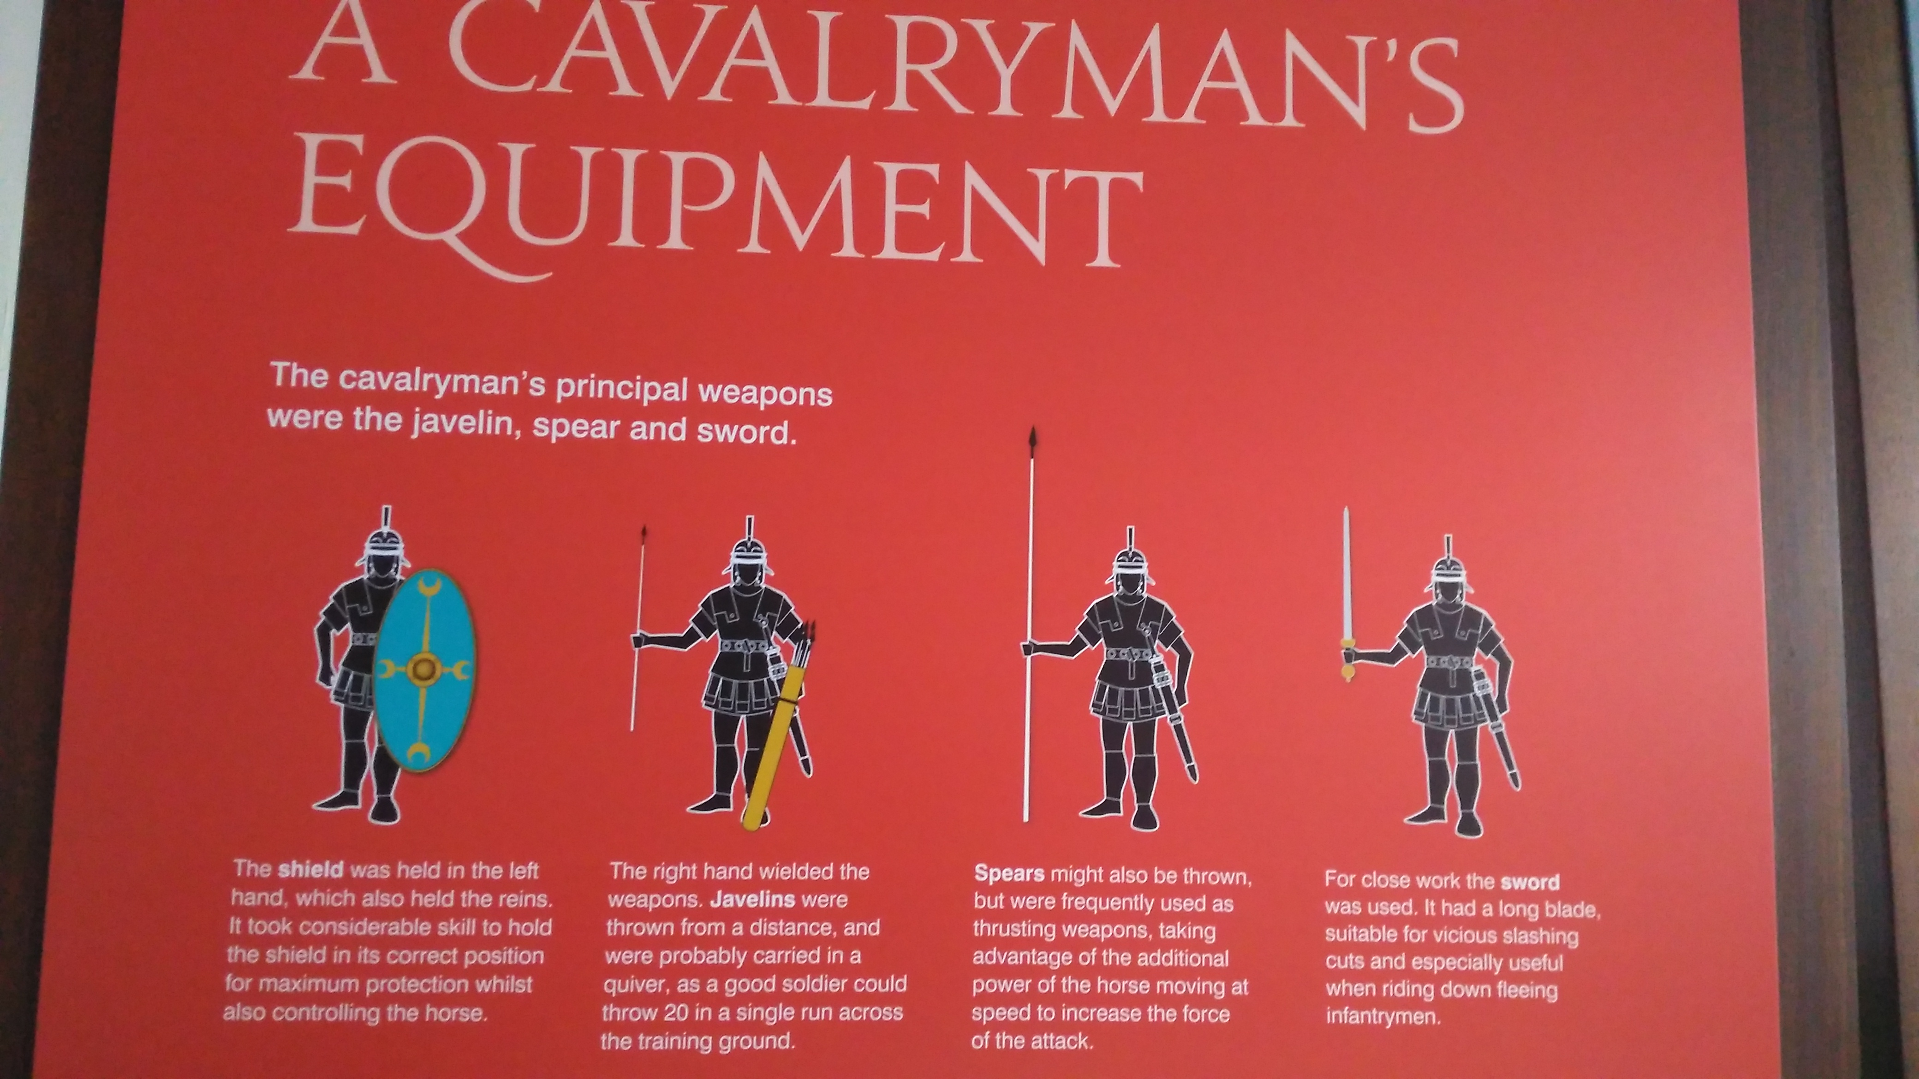

Slide 17
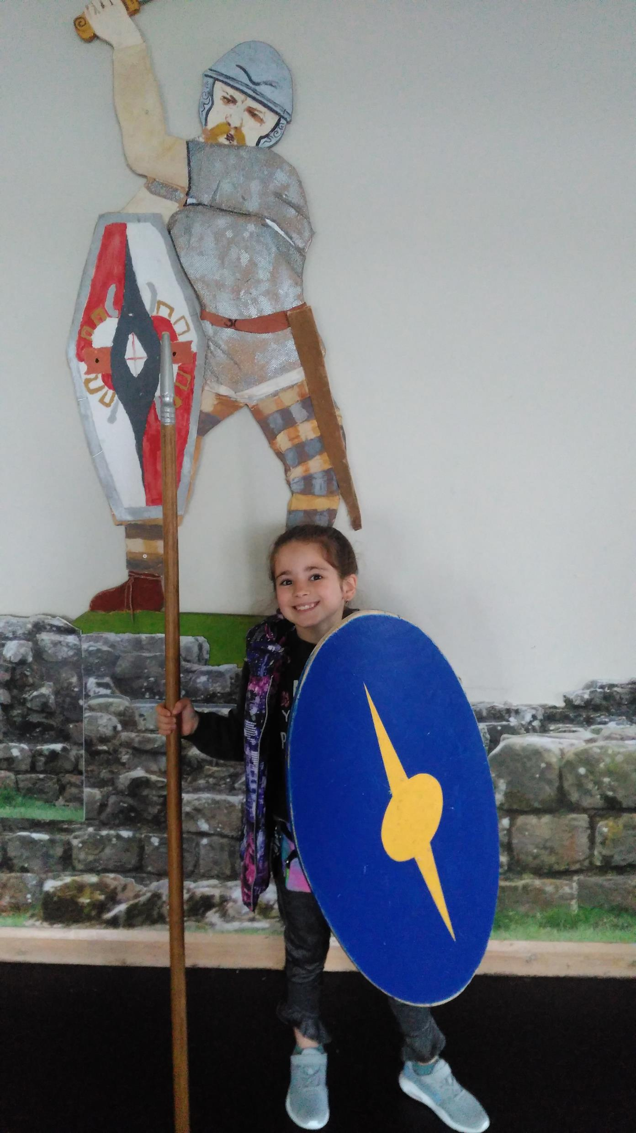
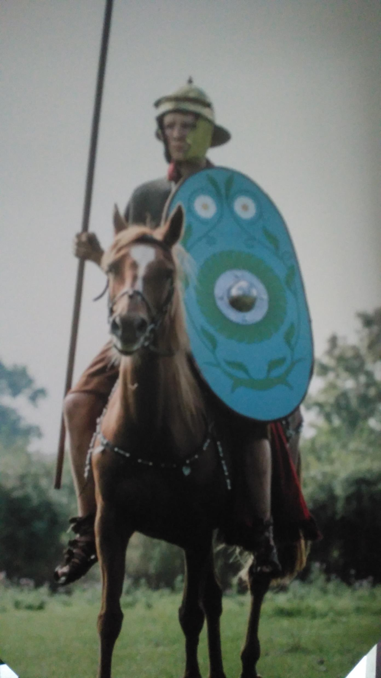
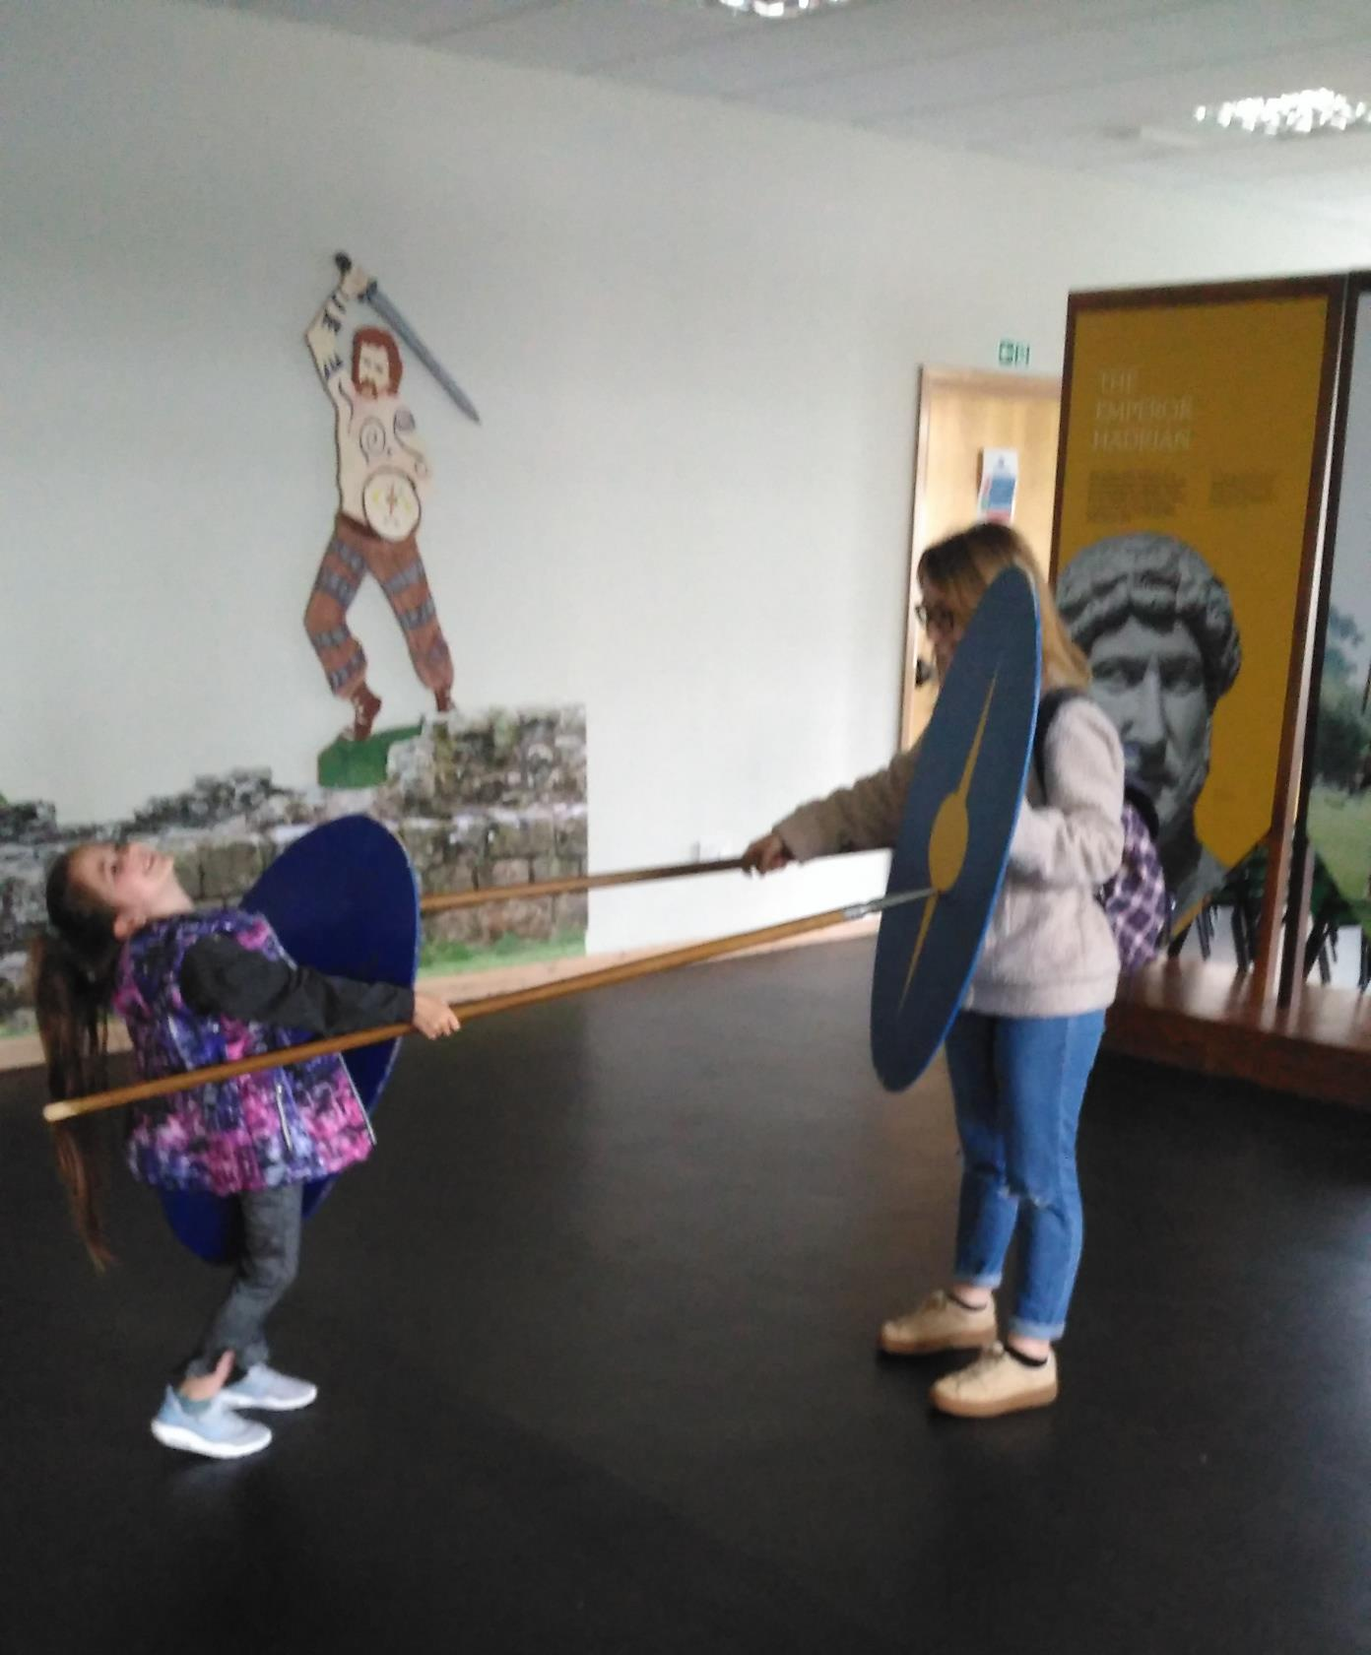

Slide 18
Hadrians Wall

Slide 19
Who was Emperor Hadrian?

Slide 20
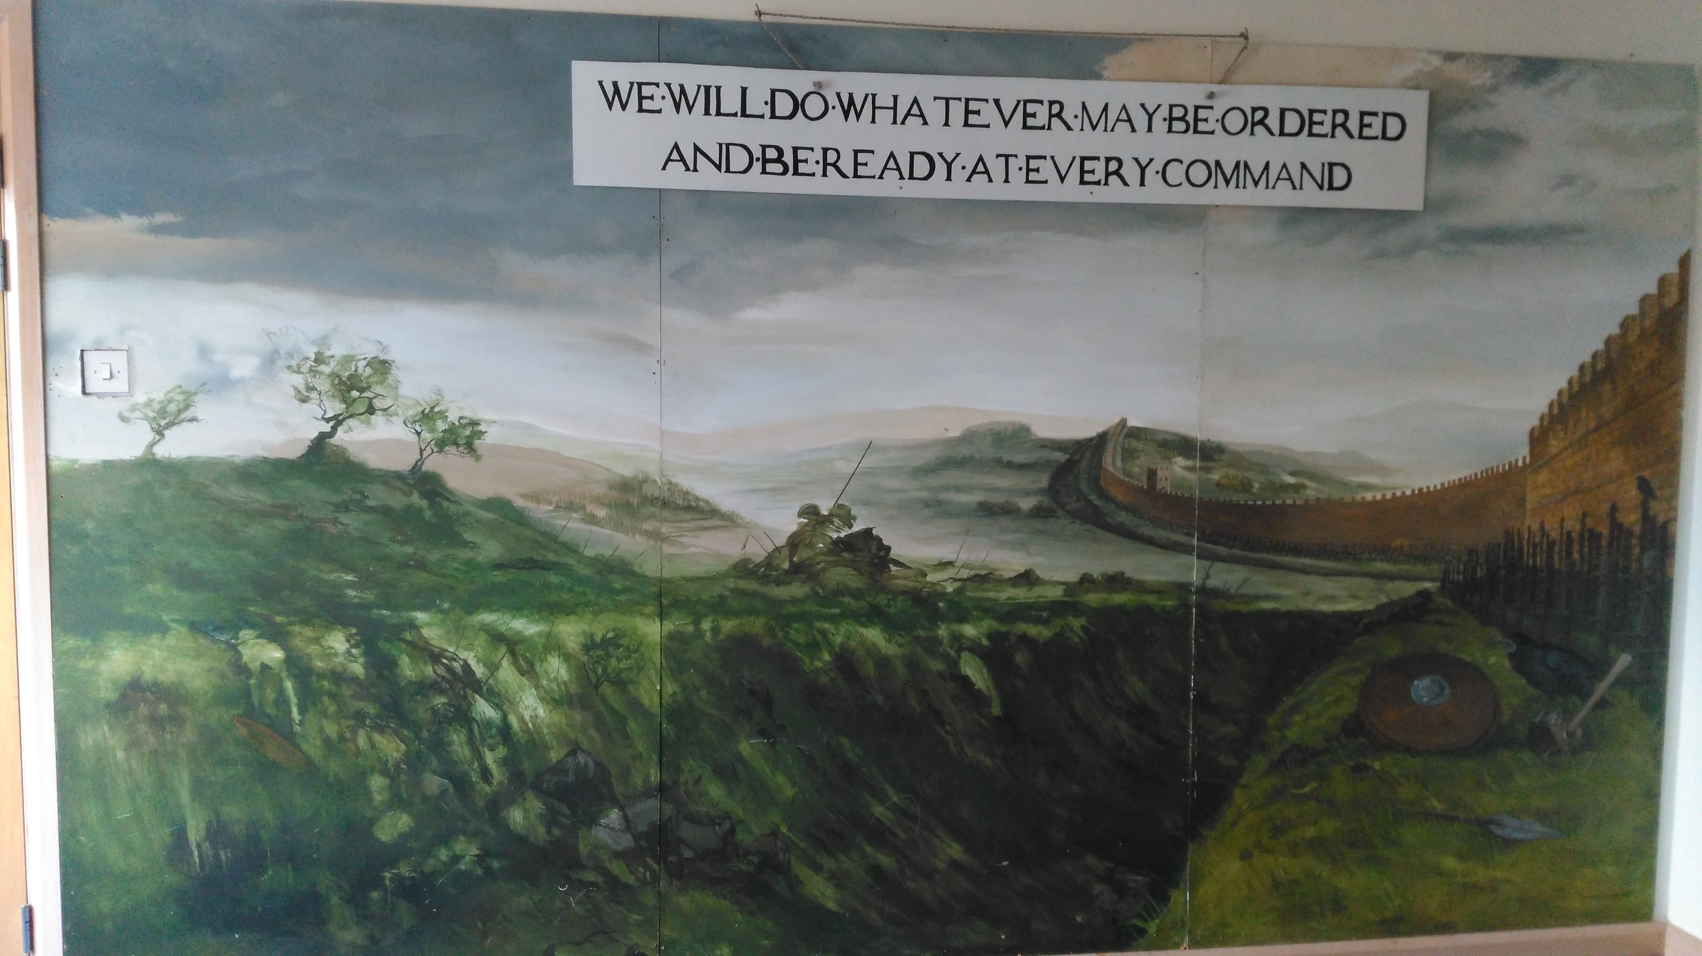
Hadrian was born in Rome in A.D. 76. He became Emperor of Rome in A.D. 117 and ruled for 21 years until A.D. 138.
Hadrian came to visit Britain in A.D. 122, one of the many stops on a tour of the western provinces of the Roman Empire. His mission was to strengthen the defences along the northern Roman Empire. It is likely that during this visit that he ordered the construction of the Wall.

Slide 21
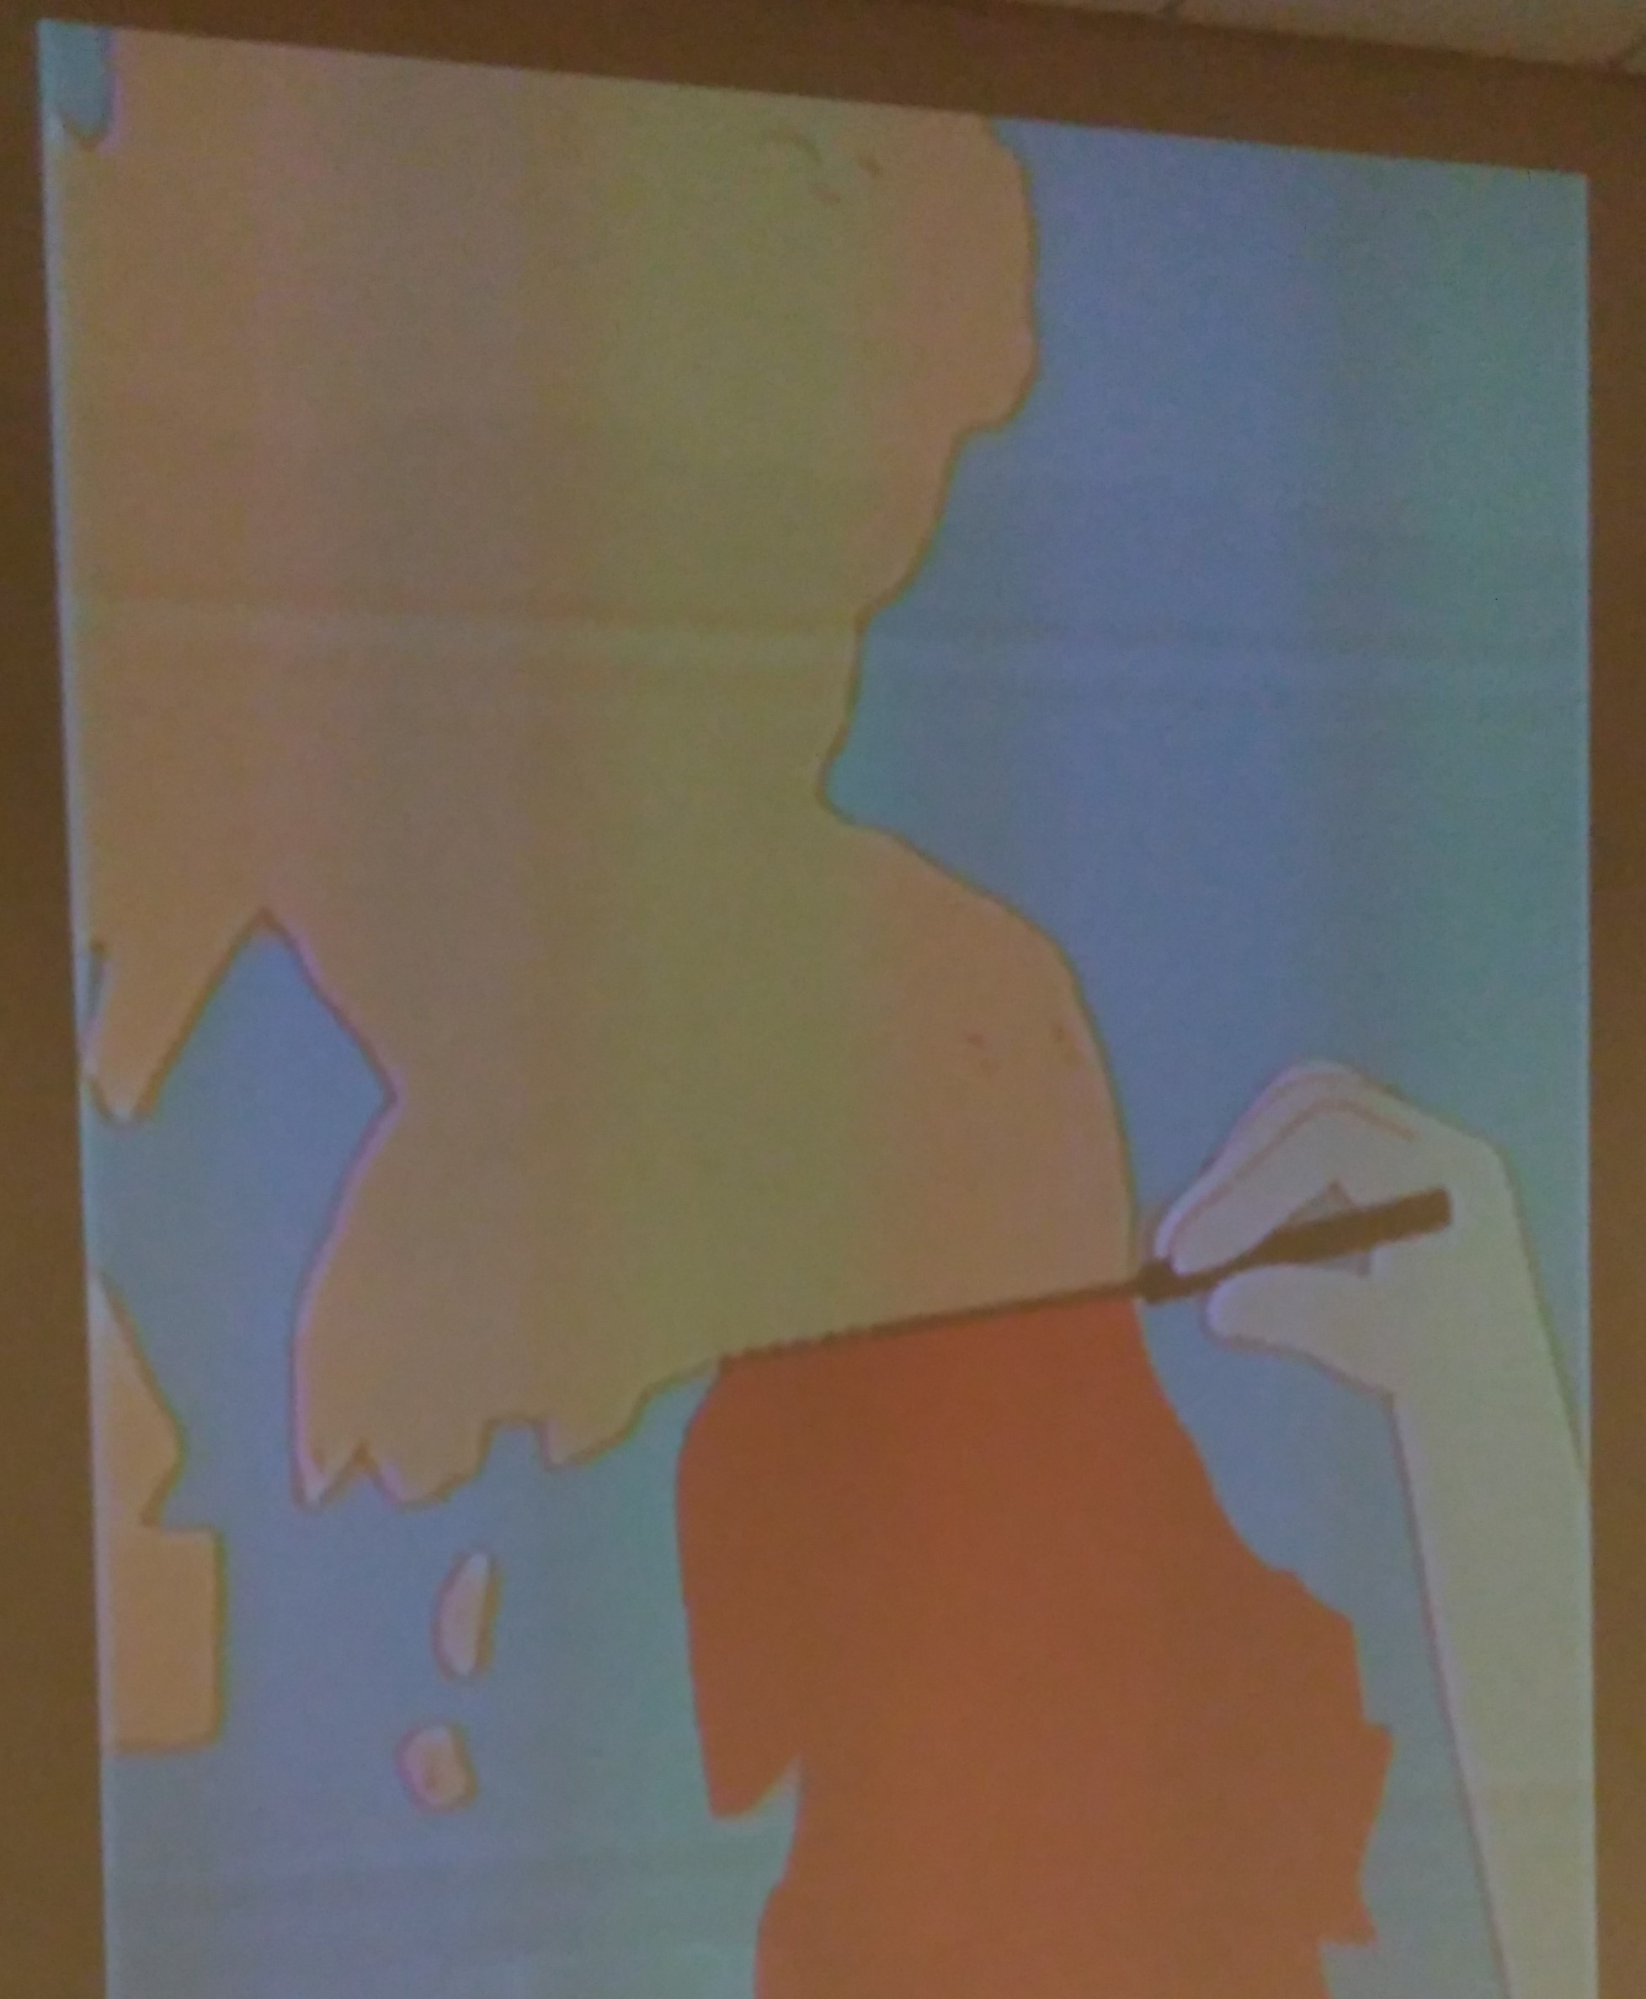
A map of great Britain showing where the wall was built across.

Slide 22
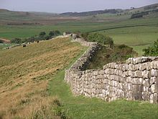
How long was Hadrian's Wall?
The Hadrians wall path you can walk is a long distance footpath in the North of England, which became the 15th National trail in 2003. It runs 84 miles (135km) from Wallsend on the East coast of England to Bowness-on-Solway on the west coast.
How wide and high was Hadrian's Wall?
The wall was eight to ten feet wide and fifteen feet high.
When did the Romans build Hadrian's Wall?
The Romans began building the wall in 122 A.D.
Why did the Romans build Hadrian's Wall?
The Romans built it because they were afraid that the people of the north might attack them. The wall was built between Roman Britain and Scotland.

Slide 24
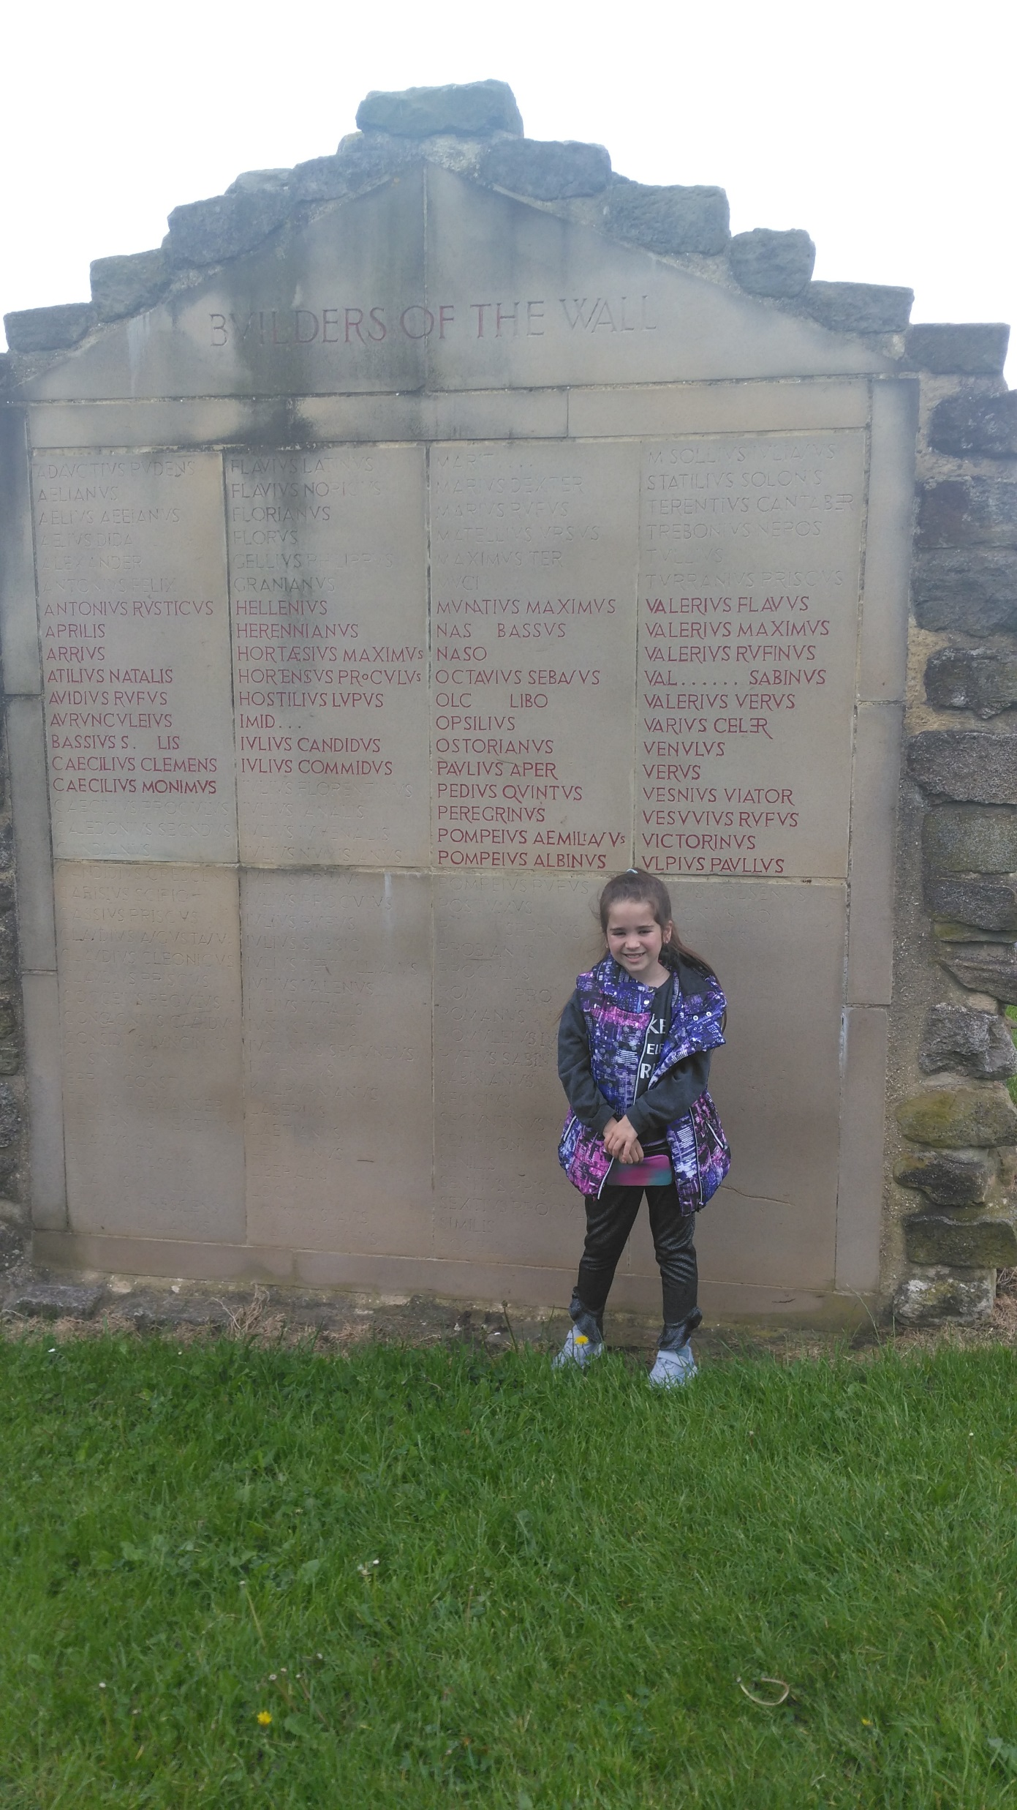
This picture is of me standing next to names engraved of some of the men who built the wall.

Slide 25
What else did I see along Hadrians Wall?

Slide 26
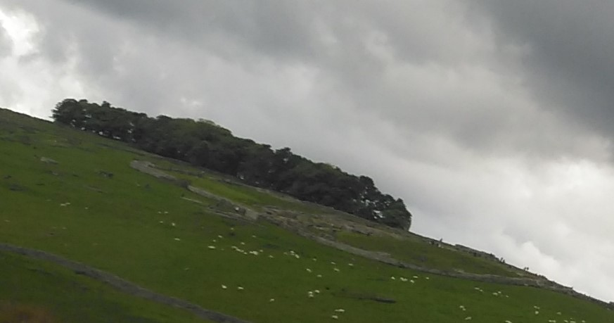
During the holidays we also visited other parts of the Hadrians wall. We drove past Housesteads Roman Fort. This is a very good one, it covers 5 acres and we took some pictures.

Slide 27
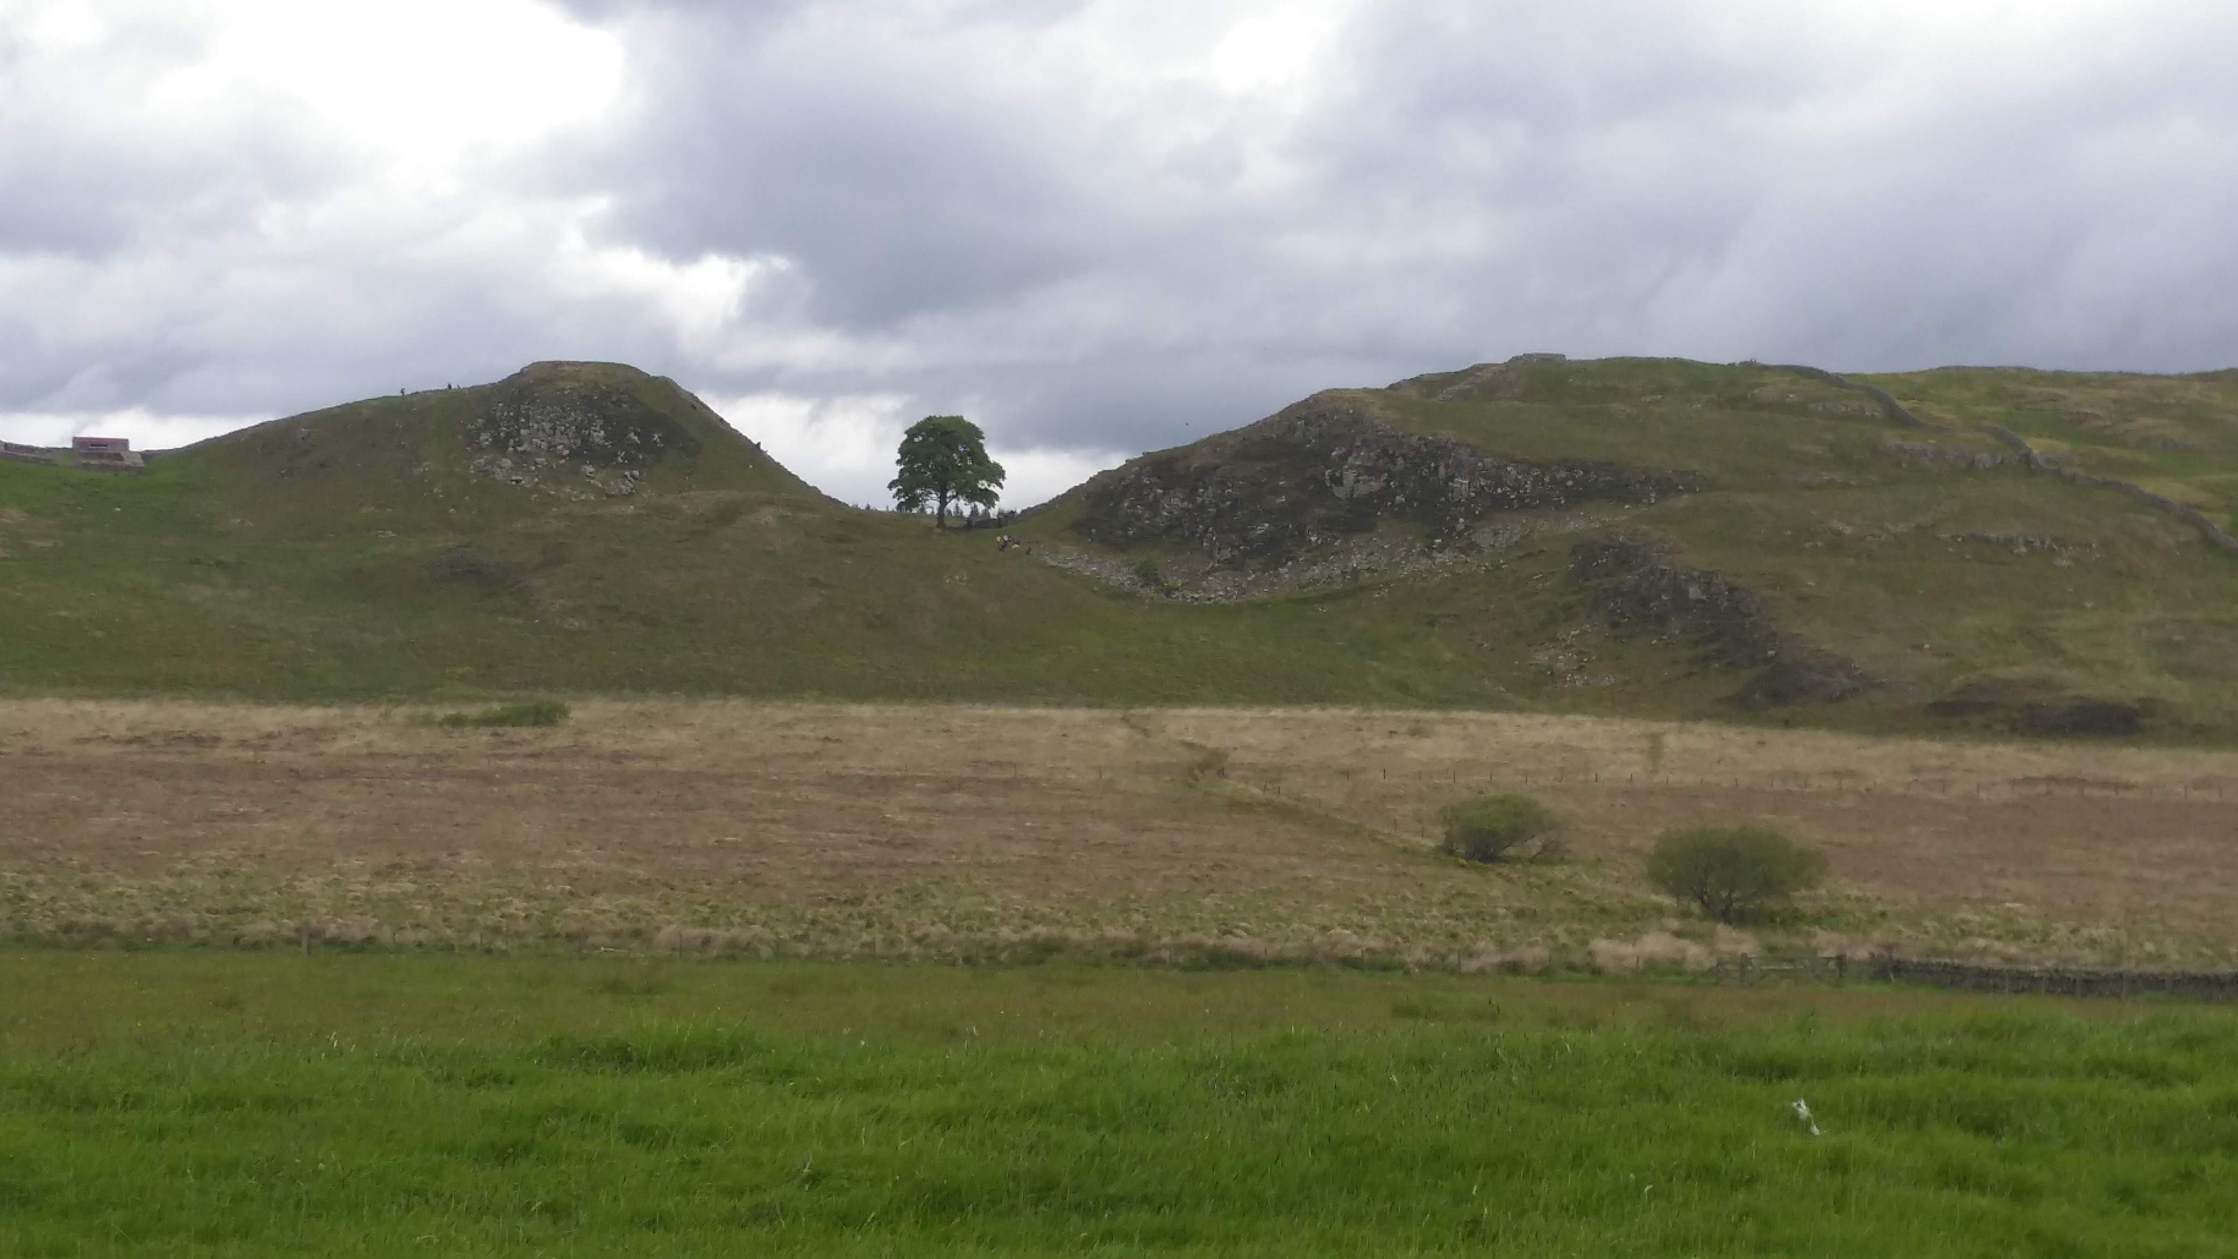
This is the Sycamore Gap that I also saw when driving along the Hadrians wall, it is a famous tree as it sits between the valley, near the wall. Lots of people visit, so I had to get a picture!

Slide 28
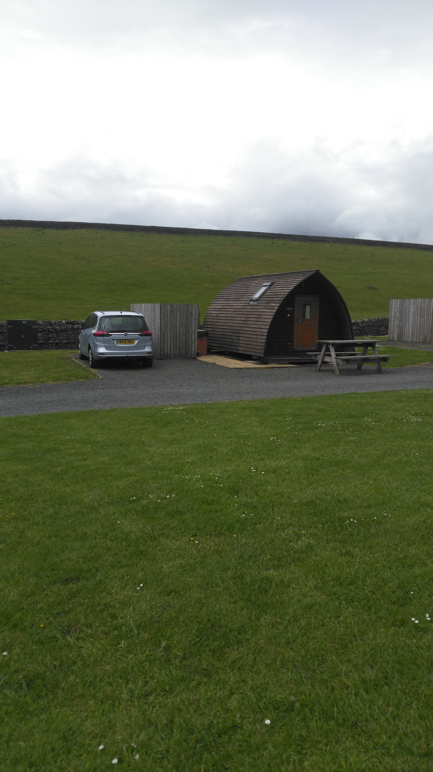
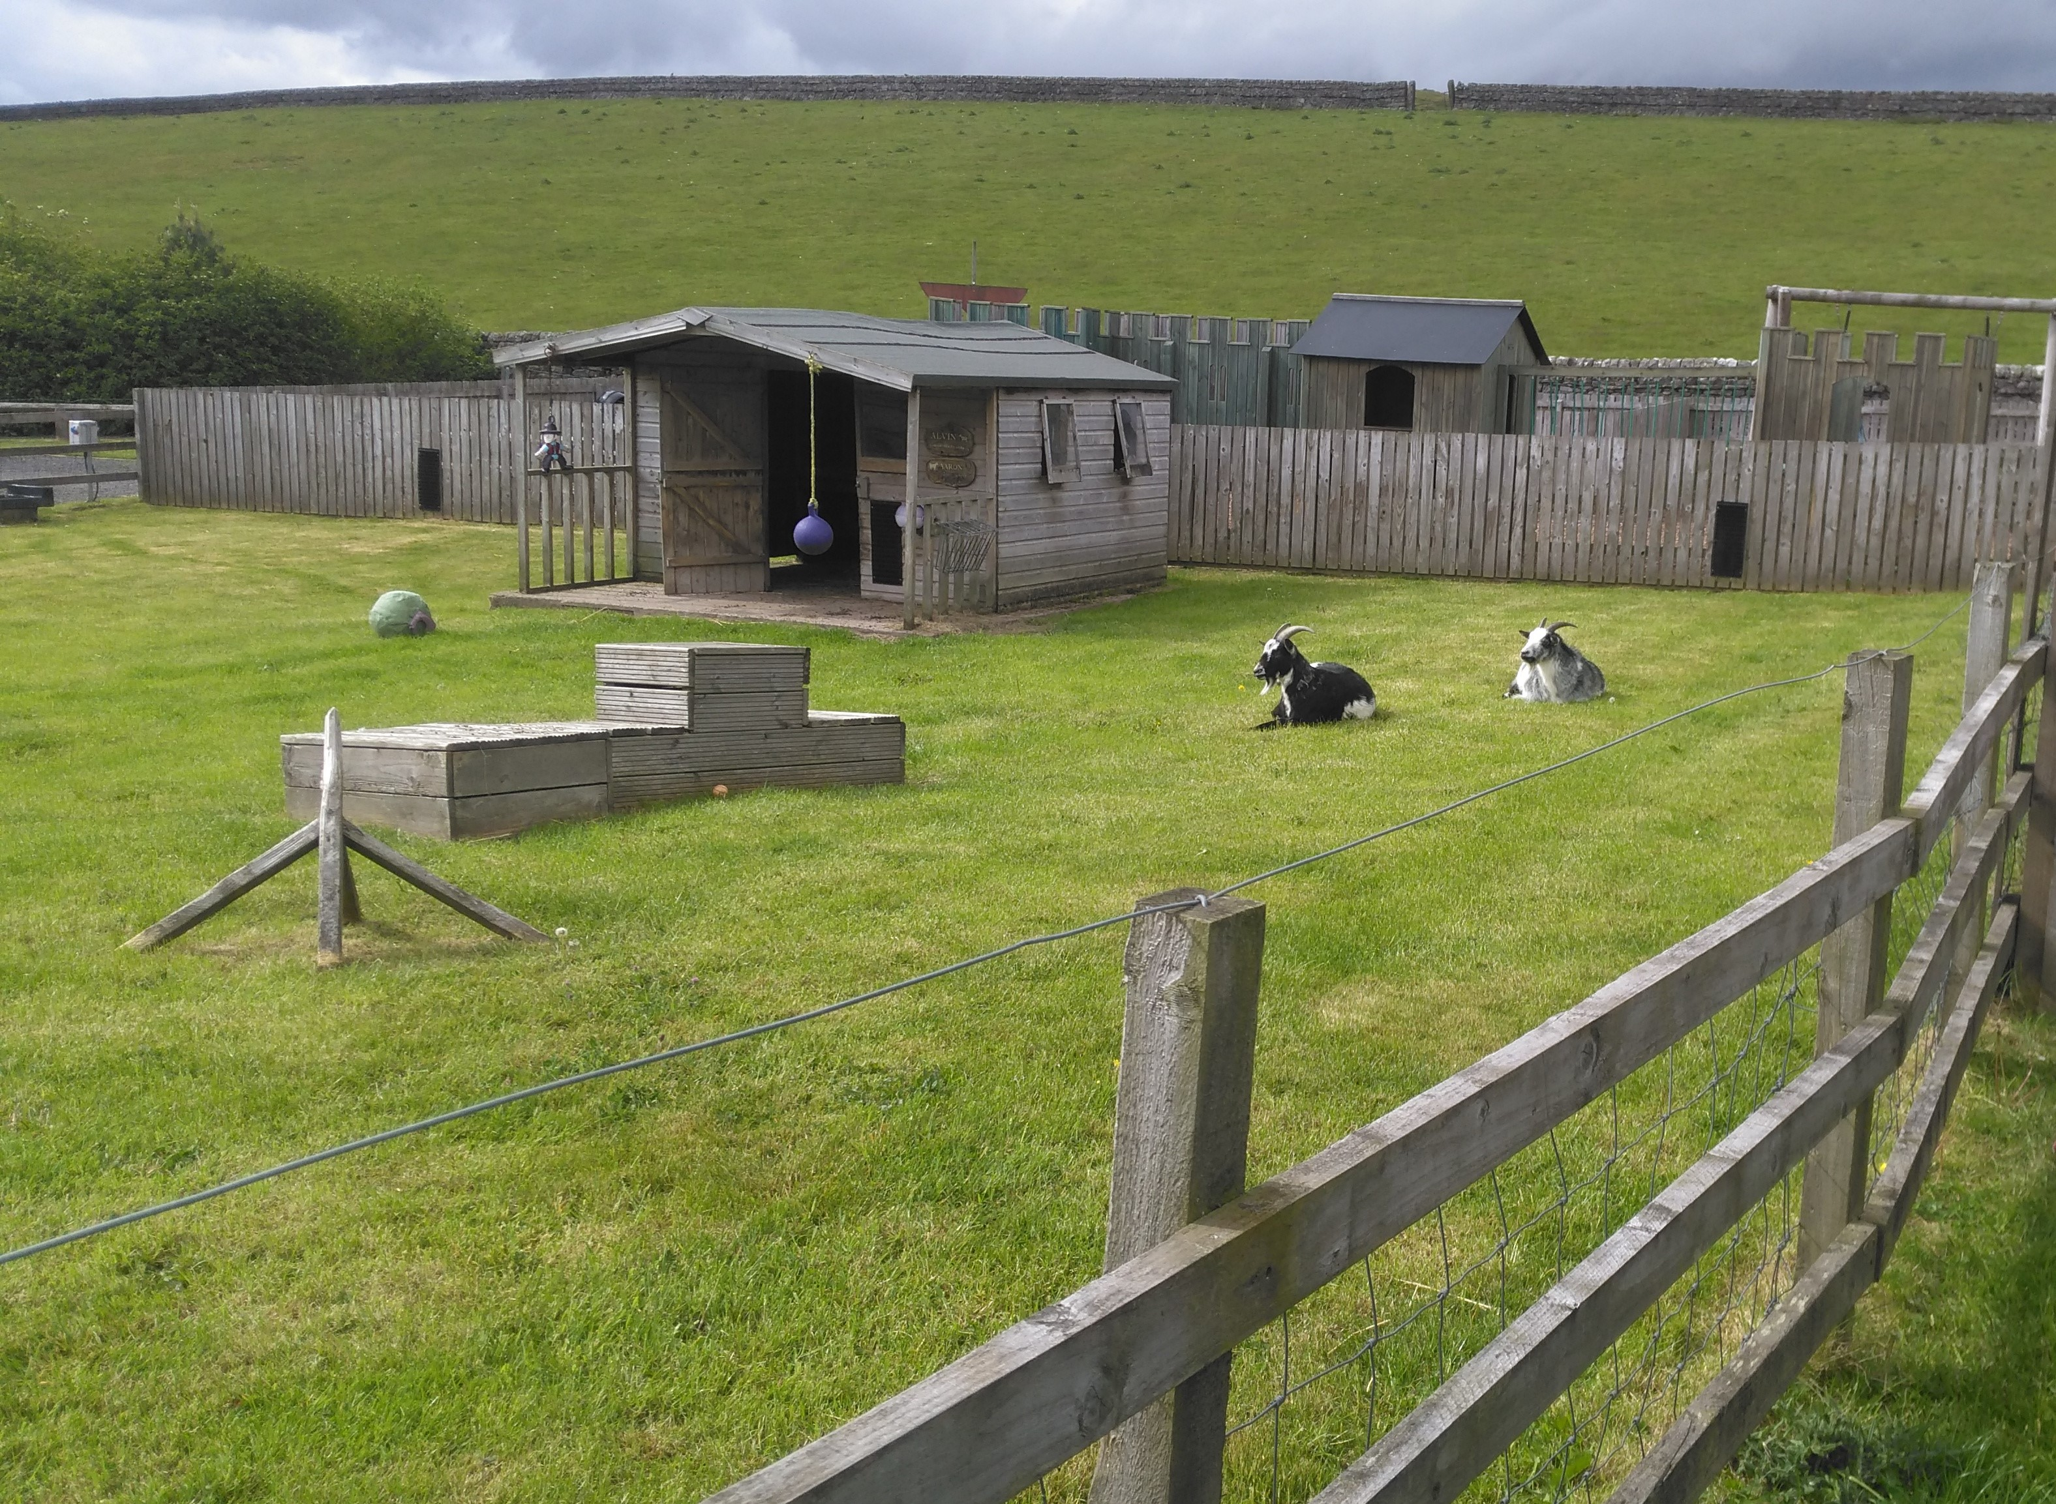
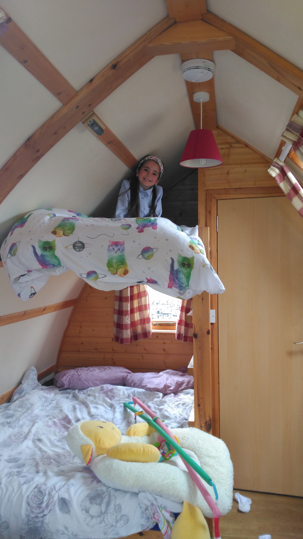
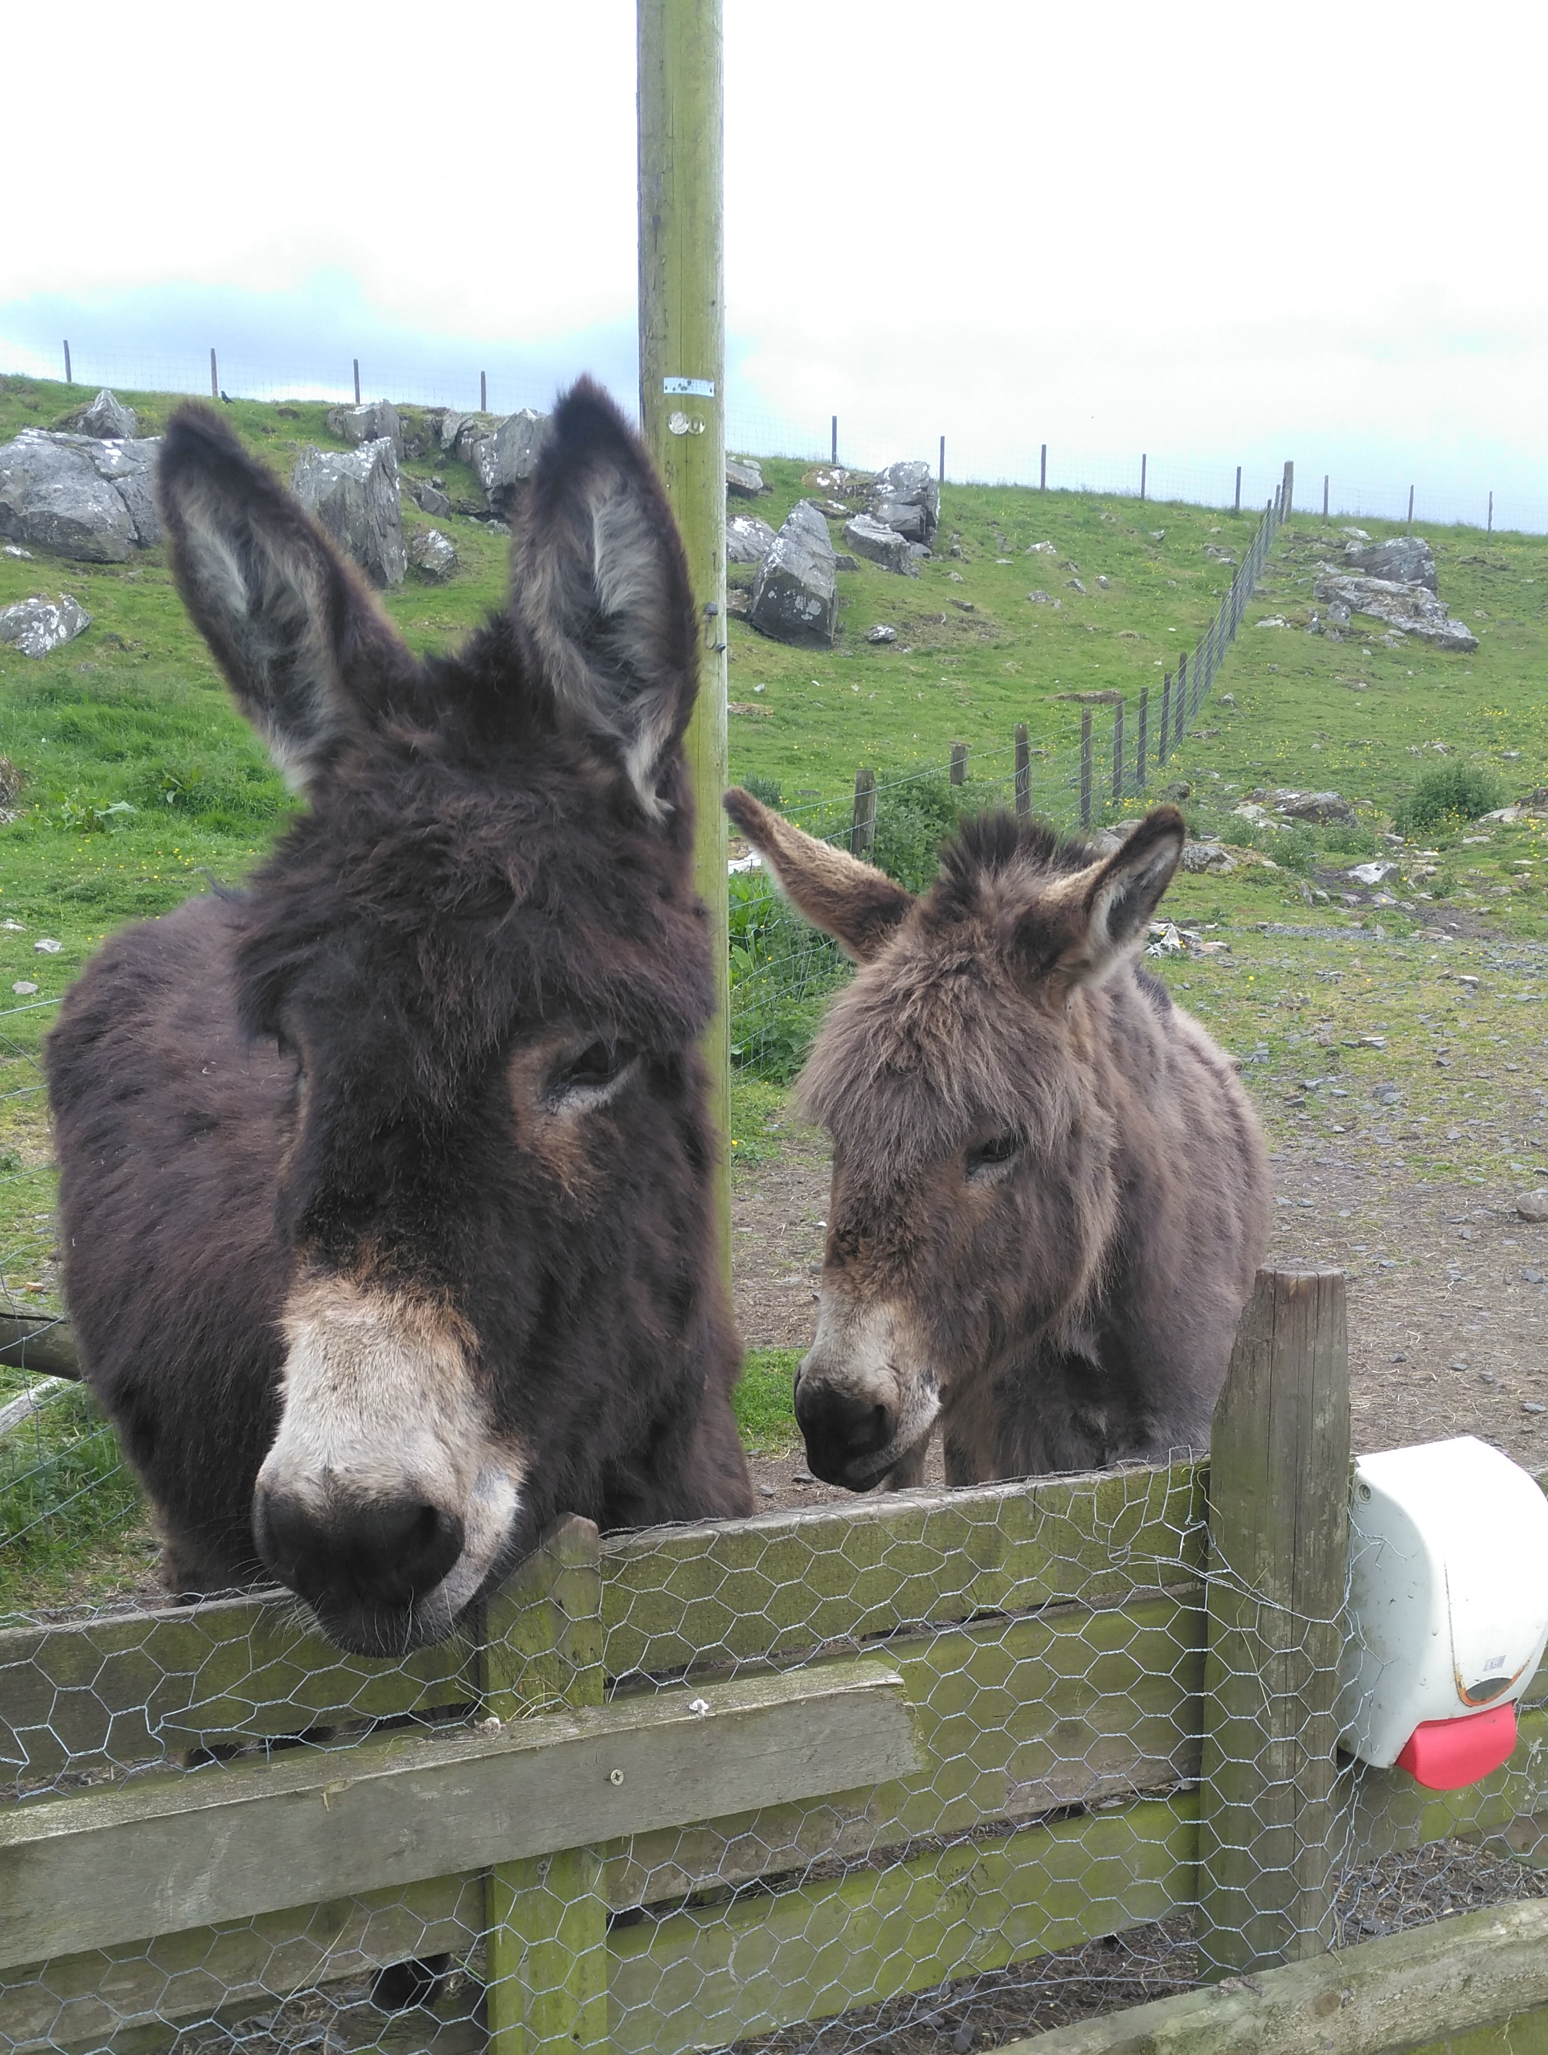
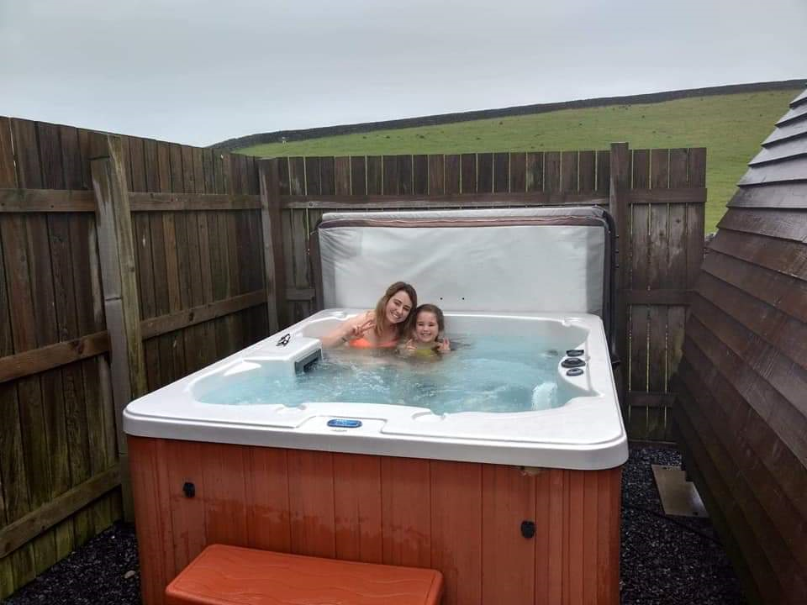
That night I stayed at Herding Hill Farm, in a wigwam called Sycamore Gap, this was funny because we had just taken a photo of the real Sycamore Gap.

Slide 29
Religion

Slide 30
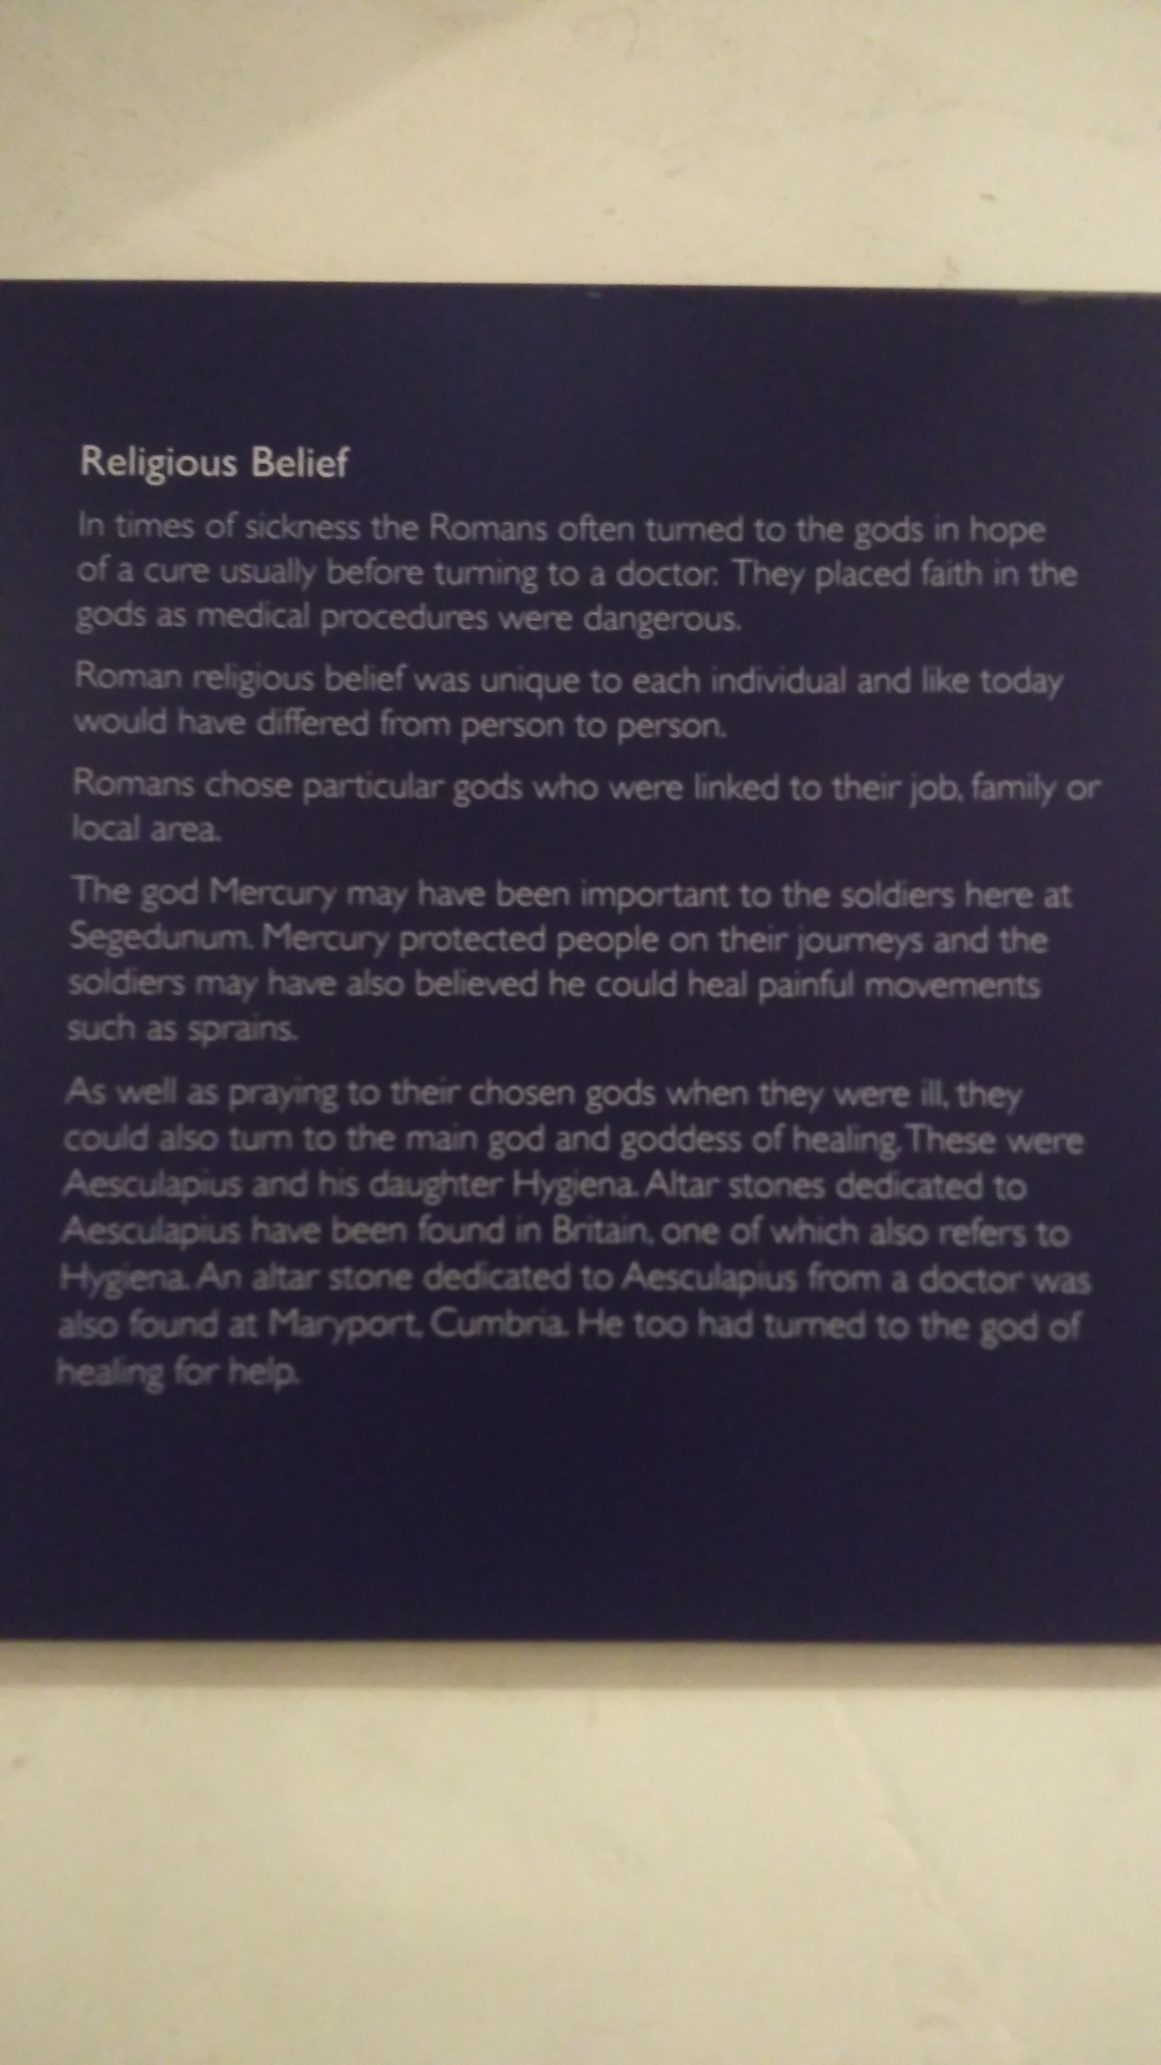

Slide 31
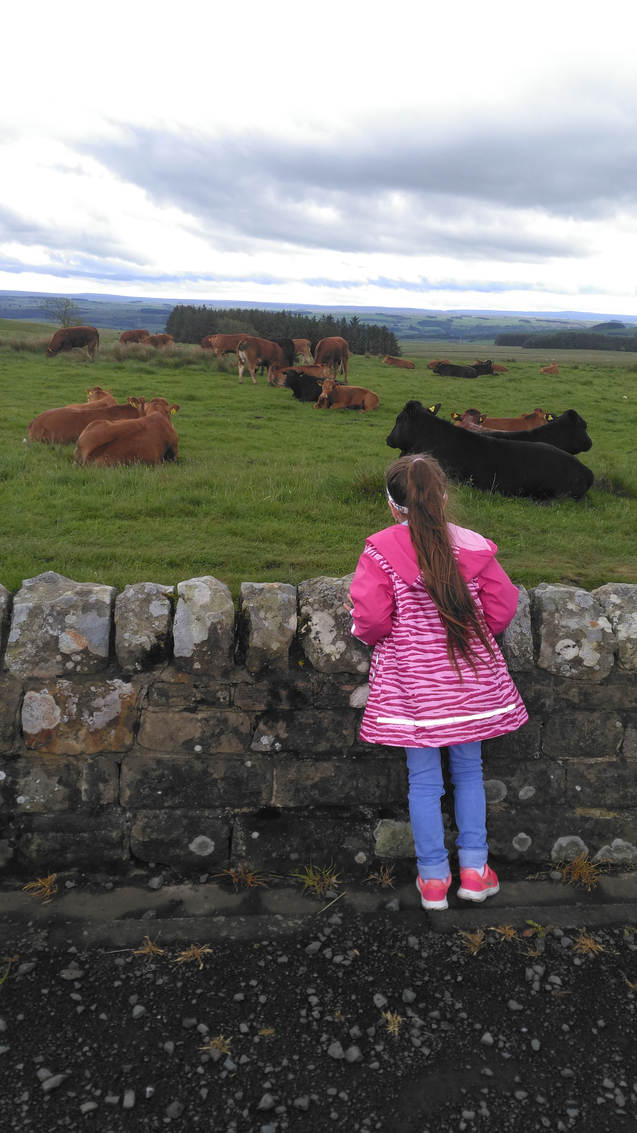
When we were exploring sights around Hadrians wall , we stopped at the Brocolitia car park in Carrawburgh.
There was lots of cows there. They were very very cheeky cows! They were trying to steal peoples picnics. Most of the cows were sitting down because it was raining . The cows were BIG !
The car park was a short walk from Mithras Temple, a place I wanted to visit for this homework. We had read that the temple ruins were worth a visit, as it was an important temple to the Romans when looking at religious beliefs.

Slide 32
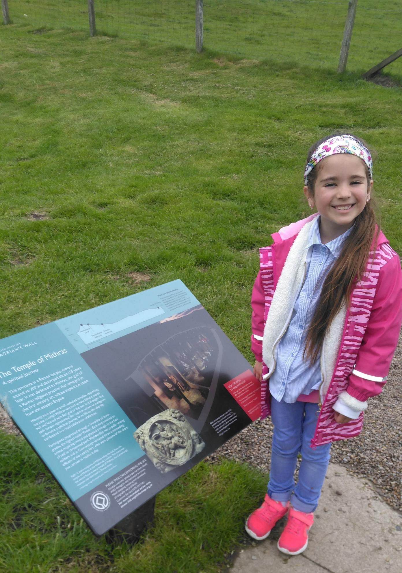

Slide 33
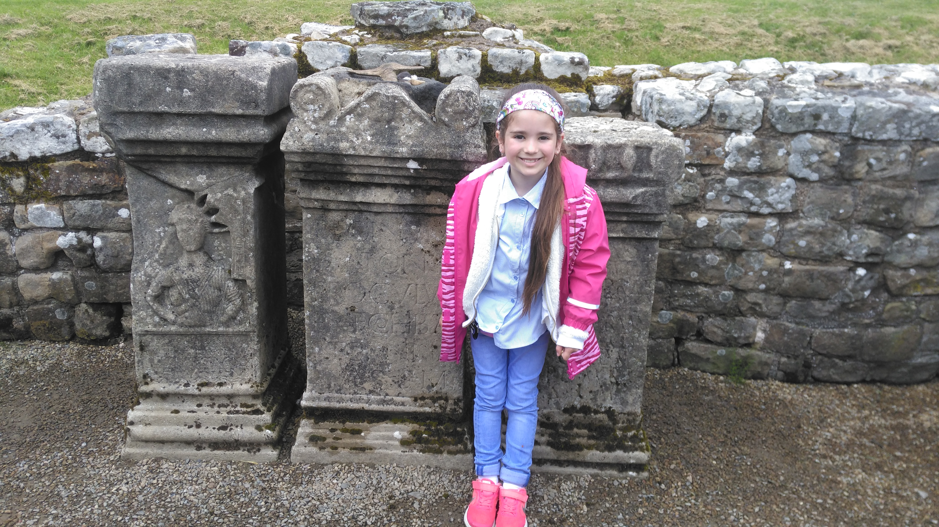
At the Mithras Temple people leave gifts and money for the Gods. I wanted to leave some of my money too.

Slide 34
Granaries

Slide 35
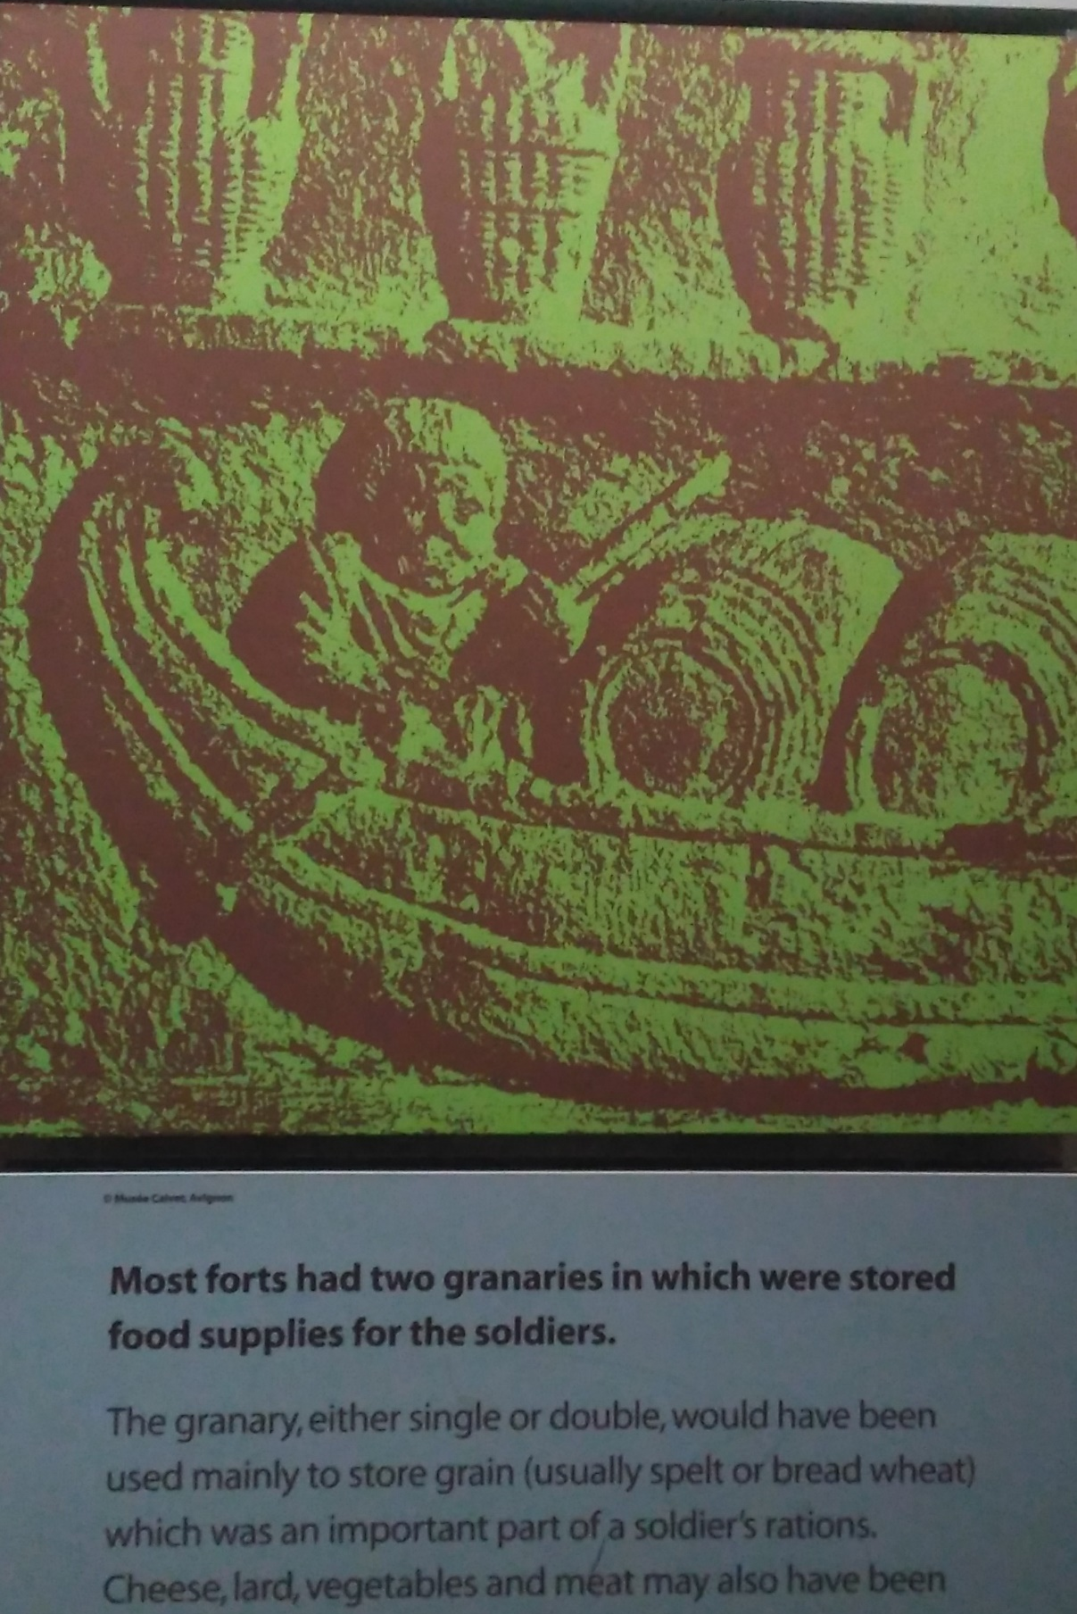
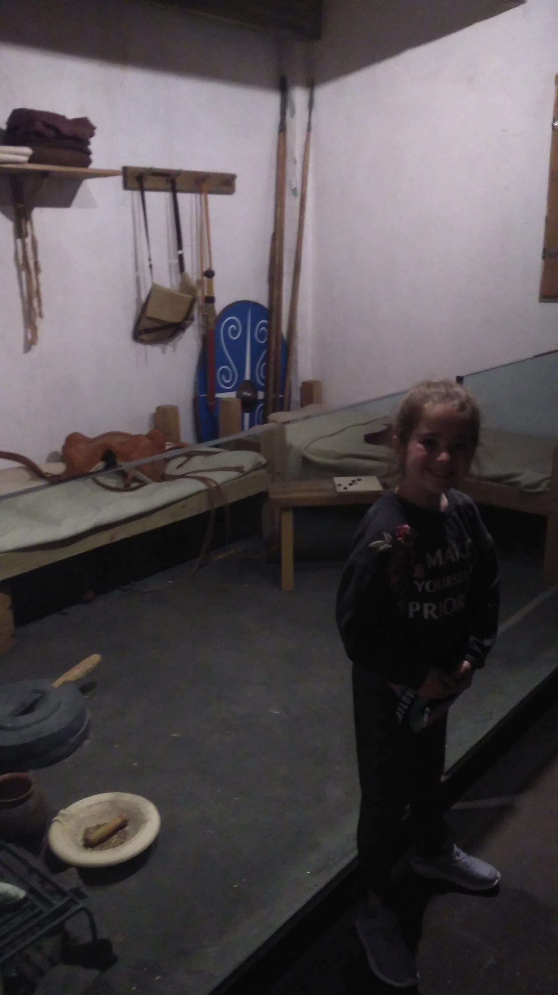
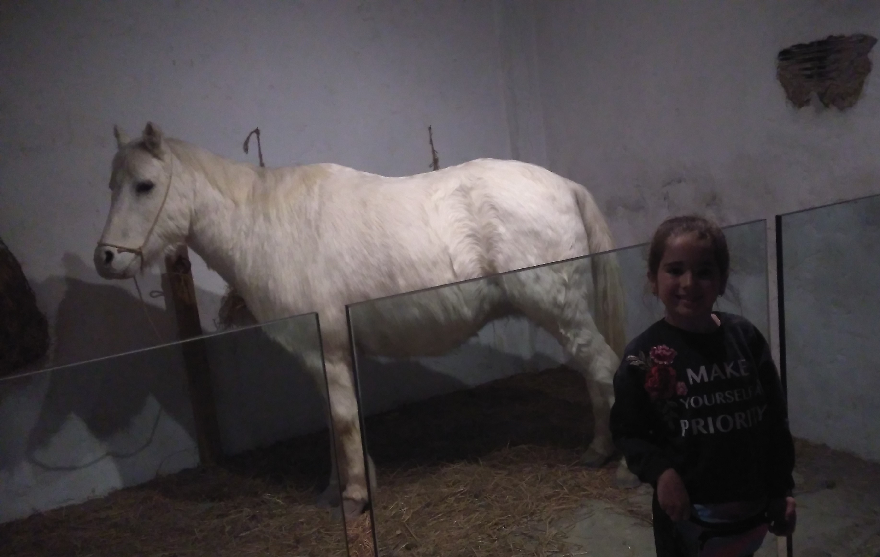
Normally soldiers slept in the back room and their horse slept in the front room.

Slide 36
Hospitals

Slide 37
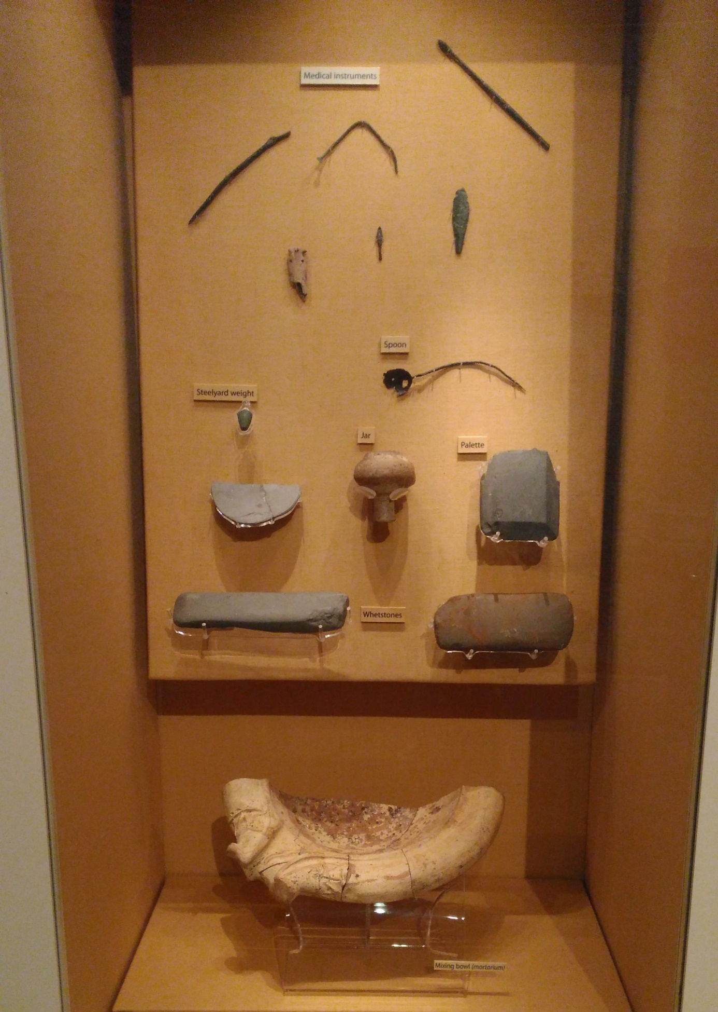
The doctor would have made his own medicines to make the sick people better.
The picture I took at Segedunum shows tools that would have been used. There was a spoon, jar and a steelyard weight.
A steelyard weight is what they used to weigh the ingredients.

Slide 38
Remains of Segedunum Roman Fort

Slide 39
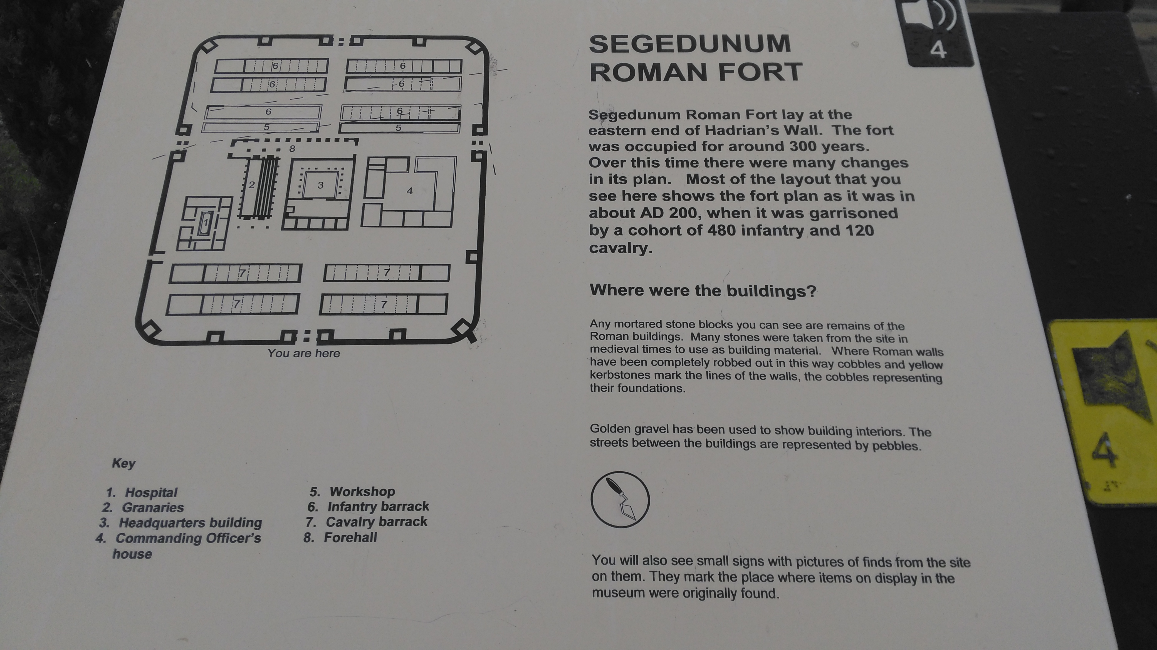

Slide 41
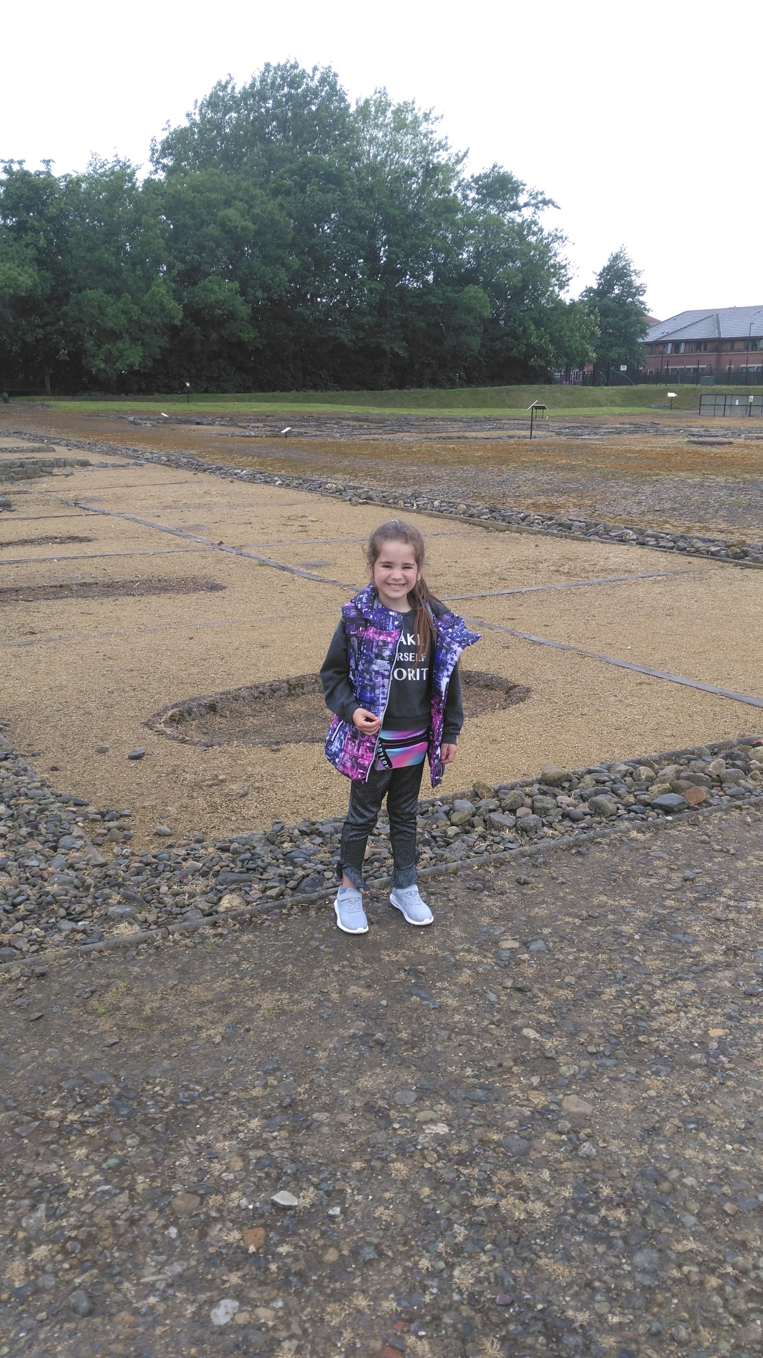
This photo is me standing in the remains of the Roman fort at Segedunum.
Where I was standing there had been houses built, it wasn’t until they knocked them down, they discovered these remains left from the Romans.

Slide 42
This picture is of some graffiti that found on parts of wall. It looks like a deer and on the other one a Roman catching a deer.

Slide 43
Amphithearte

Slide 44
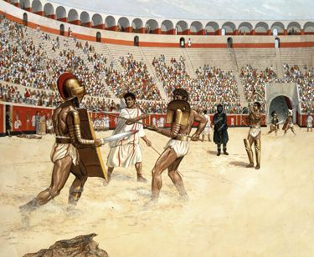
What is an Amphithearte ?
The amphitheatre was a place of entertainment in the roman times . An amphitheatre was where the Romans went to go and fight . They used to fight against wild animals such as, lions, bears and tigers. The bloodier the battle ,the more the crowd roared!

Slide 45
Roman Numerals

Slide 46
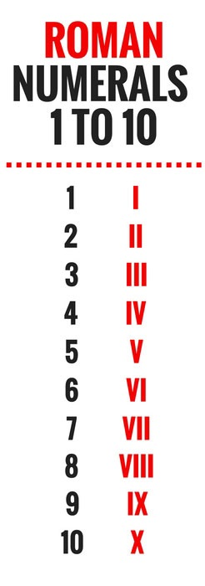
Until around 900 AD Roman Numerals were used in Ancient Rome and Europe .
After this they started to use the Arabic numbers, that we use today ( 0, 1, 2, 3, 4, 5, 6, 7, 8 ,9 ,10)

Slide 47
THANKS FOR WATCHING

