Slide 1
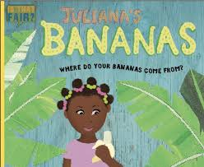
My Home Learning Grid
Week beginning - 22.2.2021
This week is Fair Trade week around the world.
We are going to be learning what Fair Trade means to food producers around the world.
Fair trade is a way of buying and selling products that allows the farmers to be paid a fair price for their produce, and have better working conditions.
Trade is ‘unfair’ when farmers receive very low income and have poor conditions while the companies that sell their products make lots of money from them.
Don’t forget to say hello on
Class Dojo!
Task 1 – Writing skills
Capital Chaos!
Have a look at the slides in this ppt about using capital letters correctly and then have a go at the task sheets or log into Education City and complete the work online.
Maths – Statistics
Data handling at primary school means gathering and recording information and then presenting it in a way that is meaningful to others. In Year 2, children are shown pictograms, tally charts, block diagrams and tables.
Lesson 1: Draw Pictograms
https://vimeo.com/504480875
Have a go at the questions throughout the video. You can draw the charts if you want to record your work for this lesson.
Lesson 2: Draw Pictograms
https://vimeo.com/504483835
The video mentions “question 3 on the worksheet”. Ignore this and complete the activity titled “Lesson 2” in this ppt.
Lesson 3: Interpret Pictograms
https://vimeo.com/504484570
The video mentions “a worksheet”. Ignore this and complete the activity titled “Lesson 3” in this ppt OR visit www.educationcity.com to complete the task Summer Fair online.
Lesson 4: Block diagrams
https://vimeo.com/504485413
The video mentions “question 3 on the worksheet”. Ignore this and complete the activity titled “Lesson 2” in this ppt OR visit www.educationcity.com to complete the task Carnival Capers online.
Task 2 – Reading for Performance
Learn off by heart one of the verses from the poem My Pet Banana by Kenn Nesbitt.
In class we are going to use actions to help our memories – just like when we are singing.
Record yourself reading it aloud – pay attention to the rhyming pattern. Include the actions you choose so we can see which ones are similar to ours in class. There’s no “right answer” to this one, just use actions that help your brain to remember…
Task 4 – Where in the World?
Our story this week focuses on a place called The Winward Islands. Can you use an atlas or Google Earth to find out where this place is?
Research the places in the world where bananas are grown and label them on a map. Label the UK as well.
Bonus Task
Can you create a fact file or information booklet about Banana production in the world?
Task 3 – Listening Skills
Join our group read of this week’s book Juliana’s Bananas on Google Meet
https://meet.google.com/dic-xpan-maj
It’s my first ever Class room Google Meet so fingers crossed it goes smoothly…
Task 5 – Cooking
In the book Juliana’s Bananas there are some tasty recipes for cooking with bananas. Can you try out the recipes at home and post a picture to your portfolio to show us what you have made.
If you’re not keen on the two recipes from the book, could you research and make your own banana creation?
Keeping in Touch
Join in with Draw with Rob on Friday pm
Look for #12 Monkey online.
https://www.youtube.com/watch?v=315EoObh3Fw
Notes:
https://teachers.thenational.academy/units/faces-shapes-and-patterns-lines-and-turns-1338

Slide 2
English Focus – Using Capital Letters in writing

Slide 3
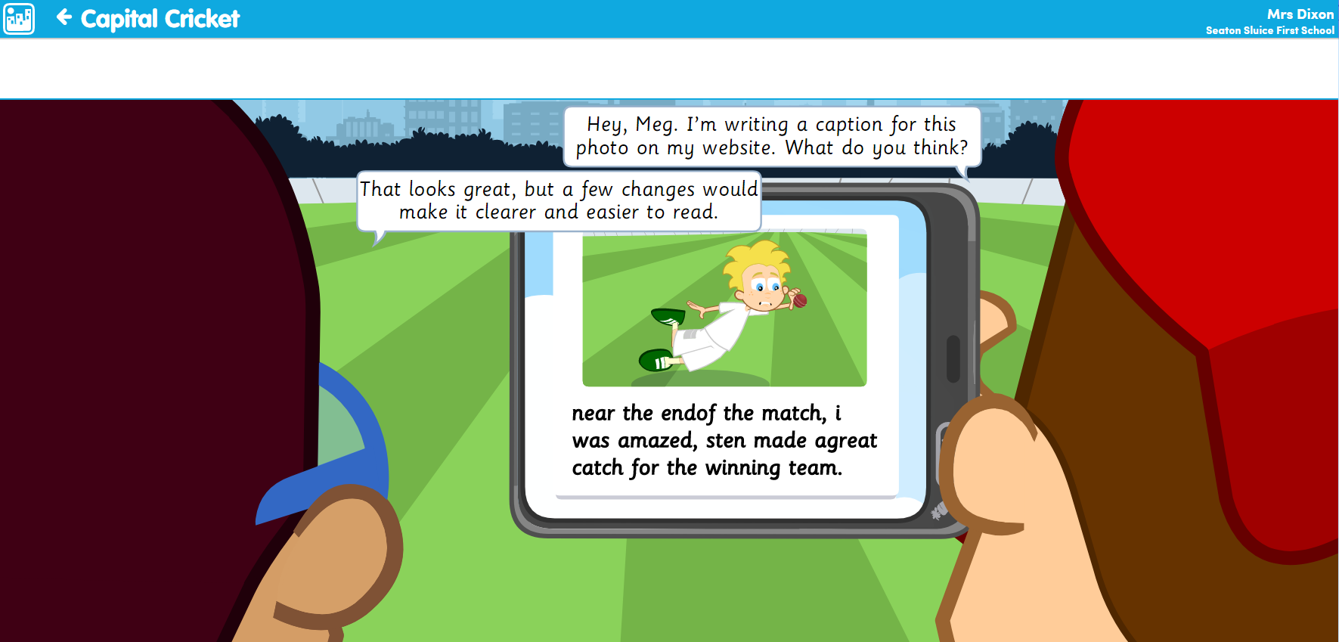

Slide 4
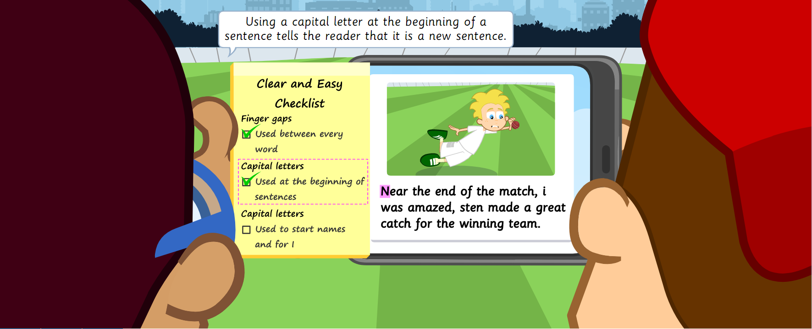

Slide 5
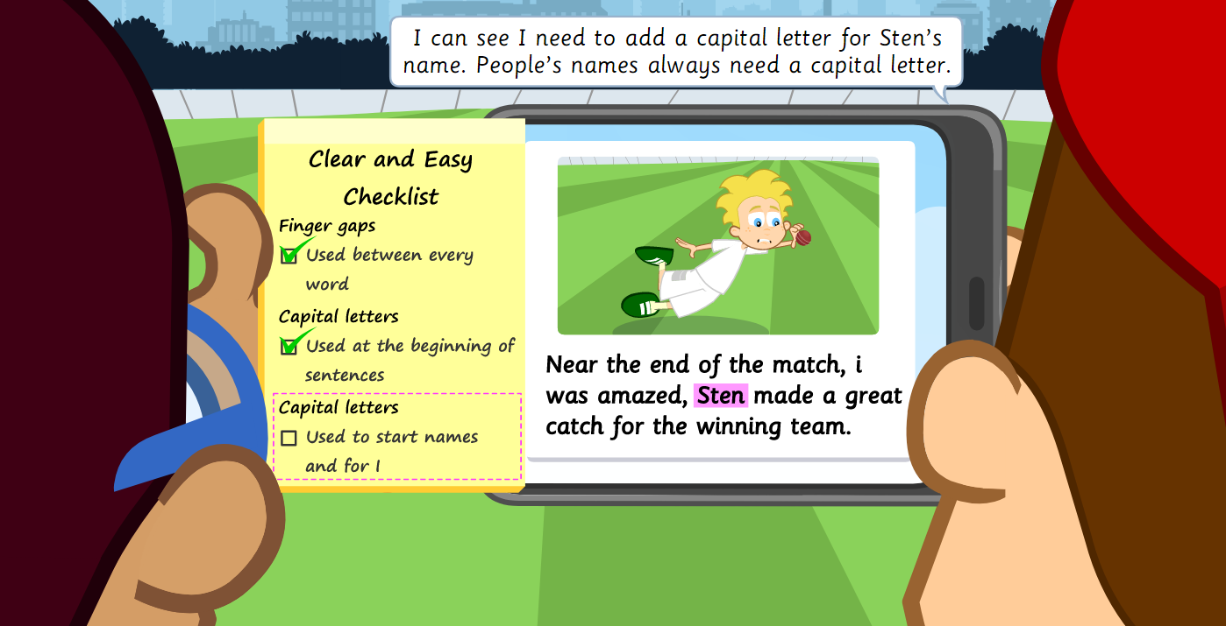

Slide 6
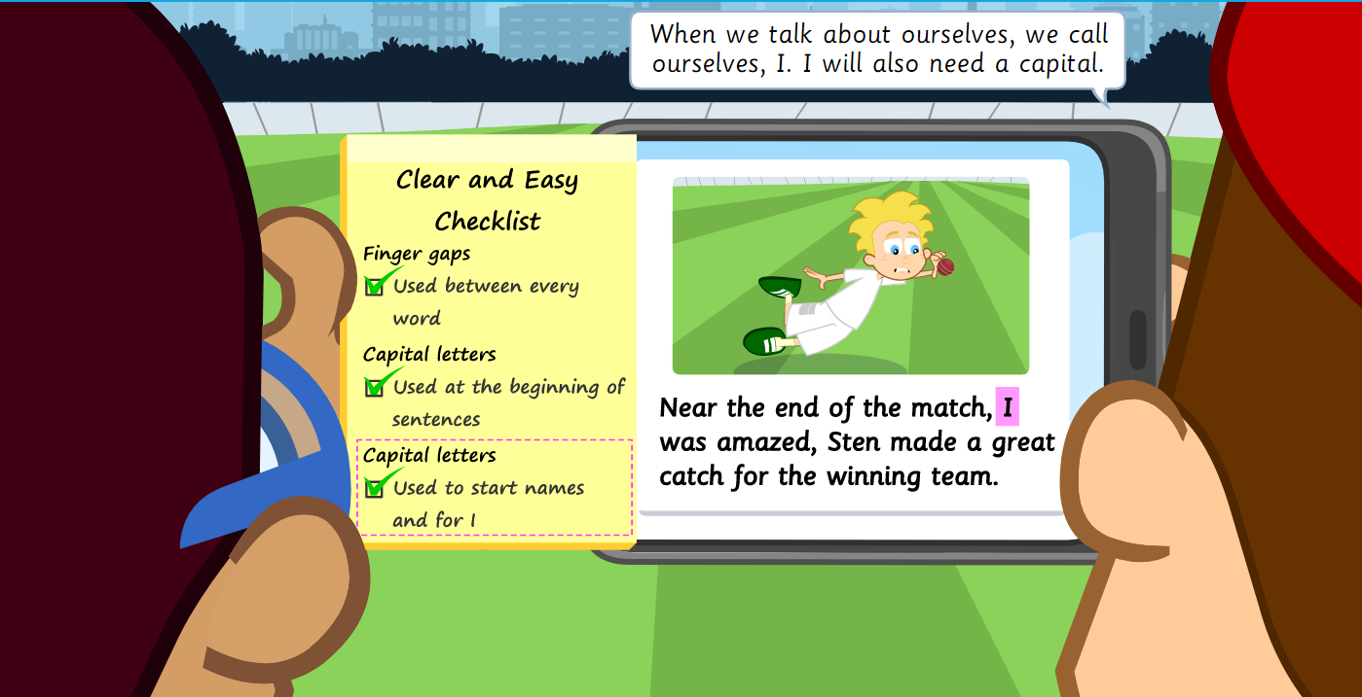

Slide 7
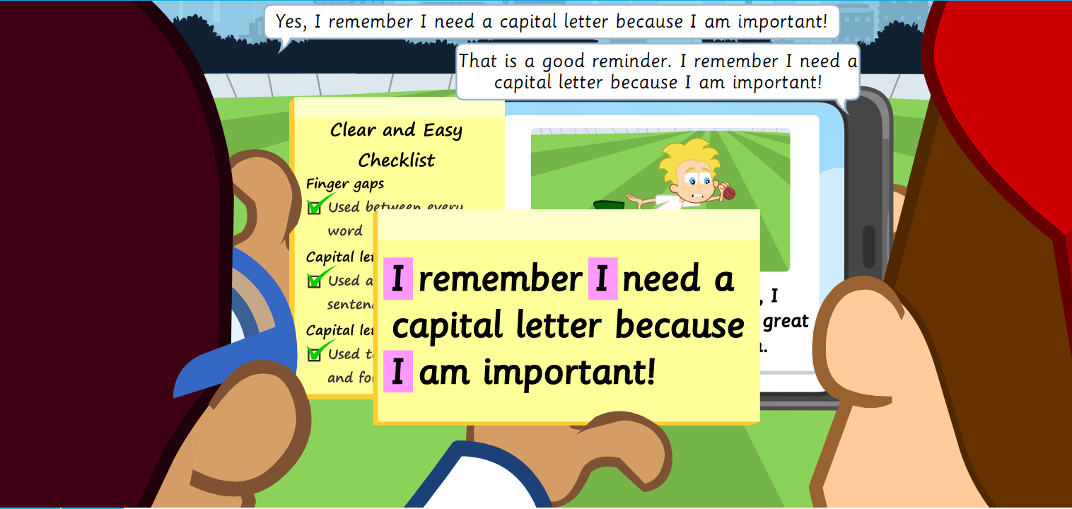

Slide 9
Click on the image to open the task sheet.
You can either print it out or write out the sentences straight onto paper.

Slide 10
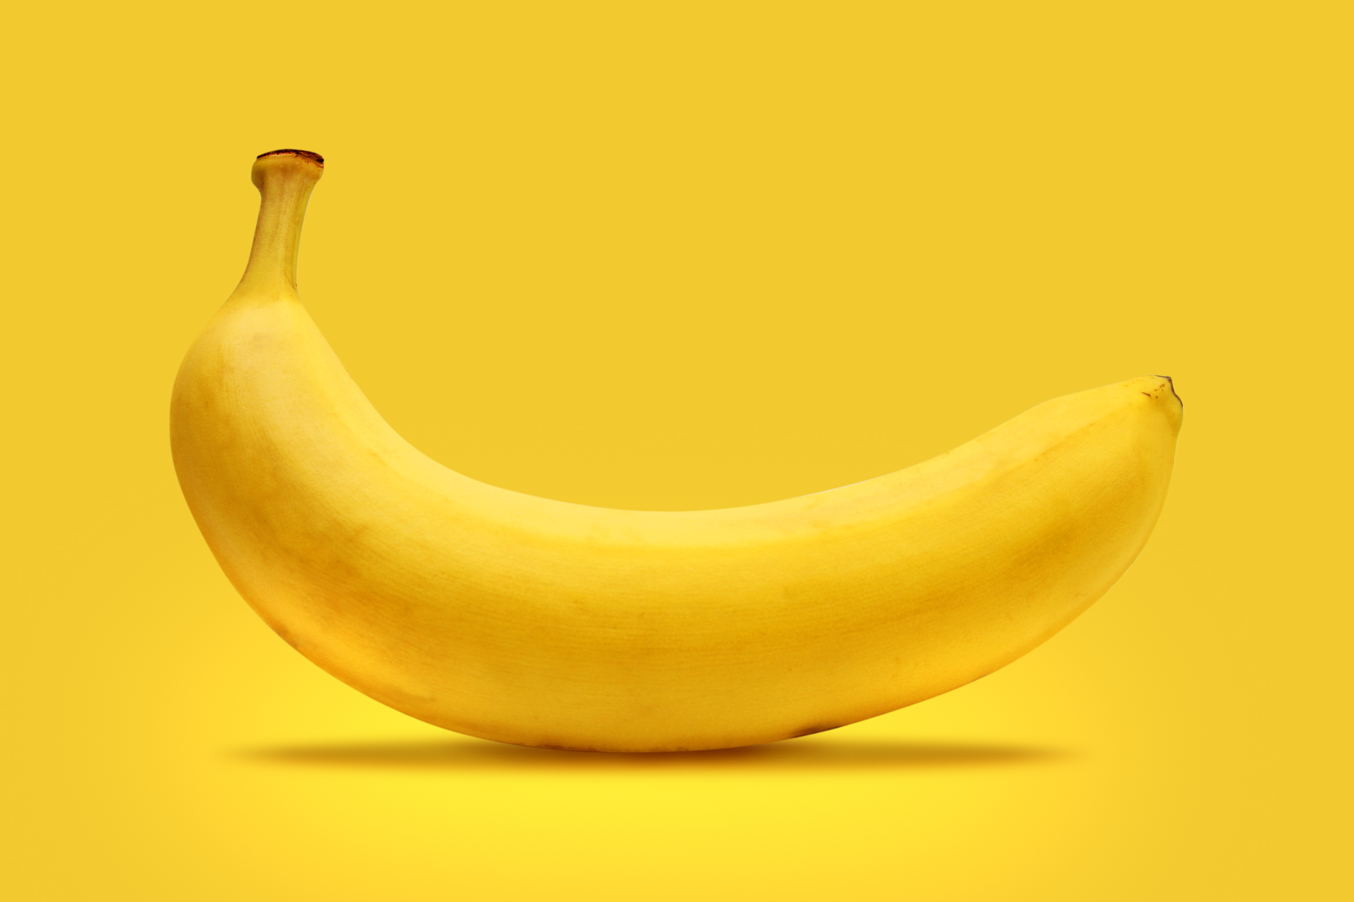
My Pet Banana – Kenn Nesbitt
I bought a pet banana and I tried to teach him tricks, but he wasn’t any good at catching balls or fetching sticks.
He could never catch a Frisbee, and he wouldn’t sit or speak, though we practiced every afternoon and evening for a week.
Though I liked my pet banana, I returned him with regret. Boy, I sure do hope this watermelon makes a better pet.

Slide 11
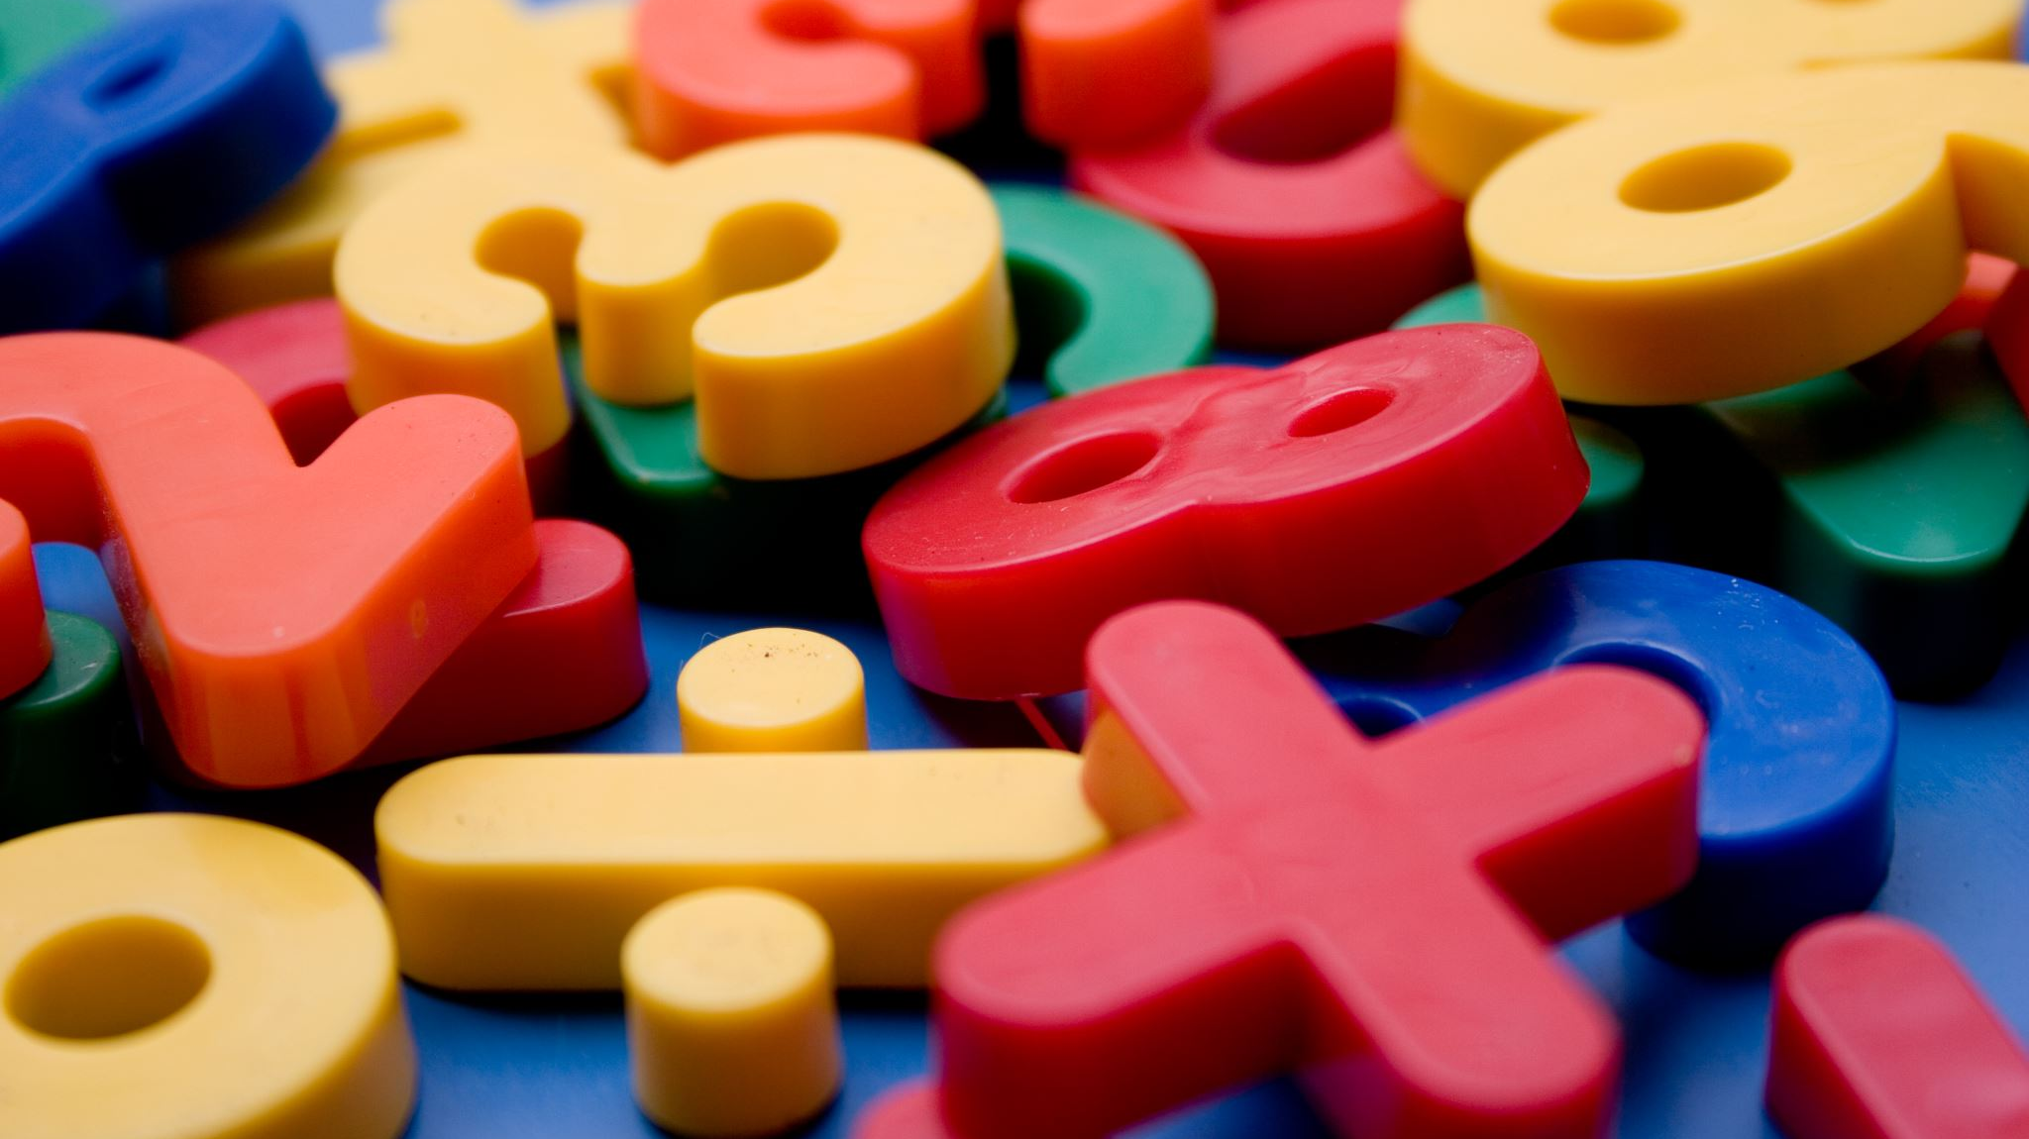
Maths Lesson 2 Click on the image to download the task sheet
https://vimeo.com/504483835

Slide 12
Maths Lesson 3 Click on the image to download the task sheet
https://vimeo.com/504484570

Slide 13
Maths Lesson 4 Click on the image to download the task sheet
https://vimeo.com/504485413

Slide 14
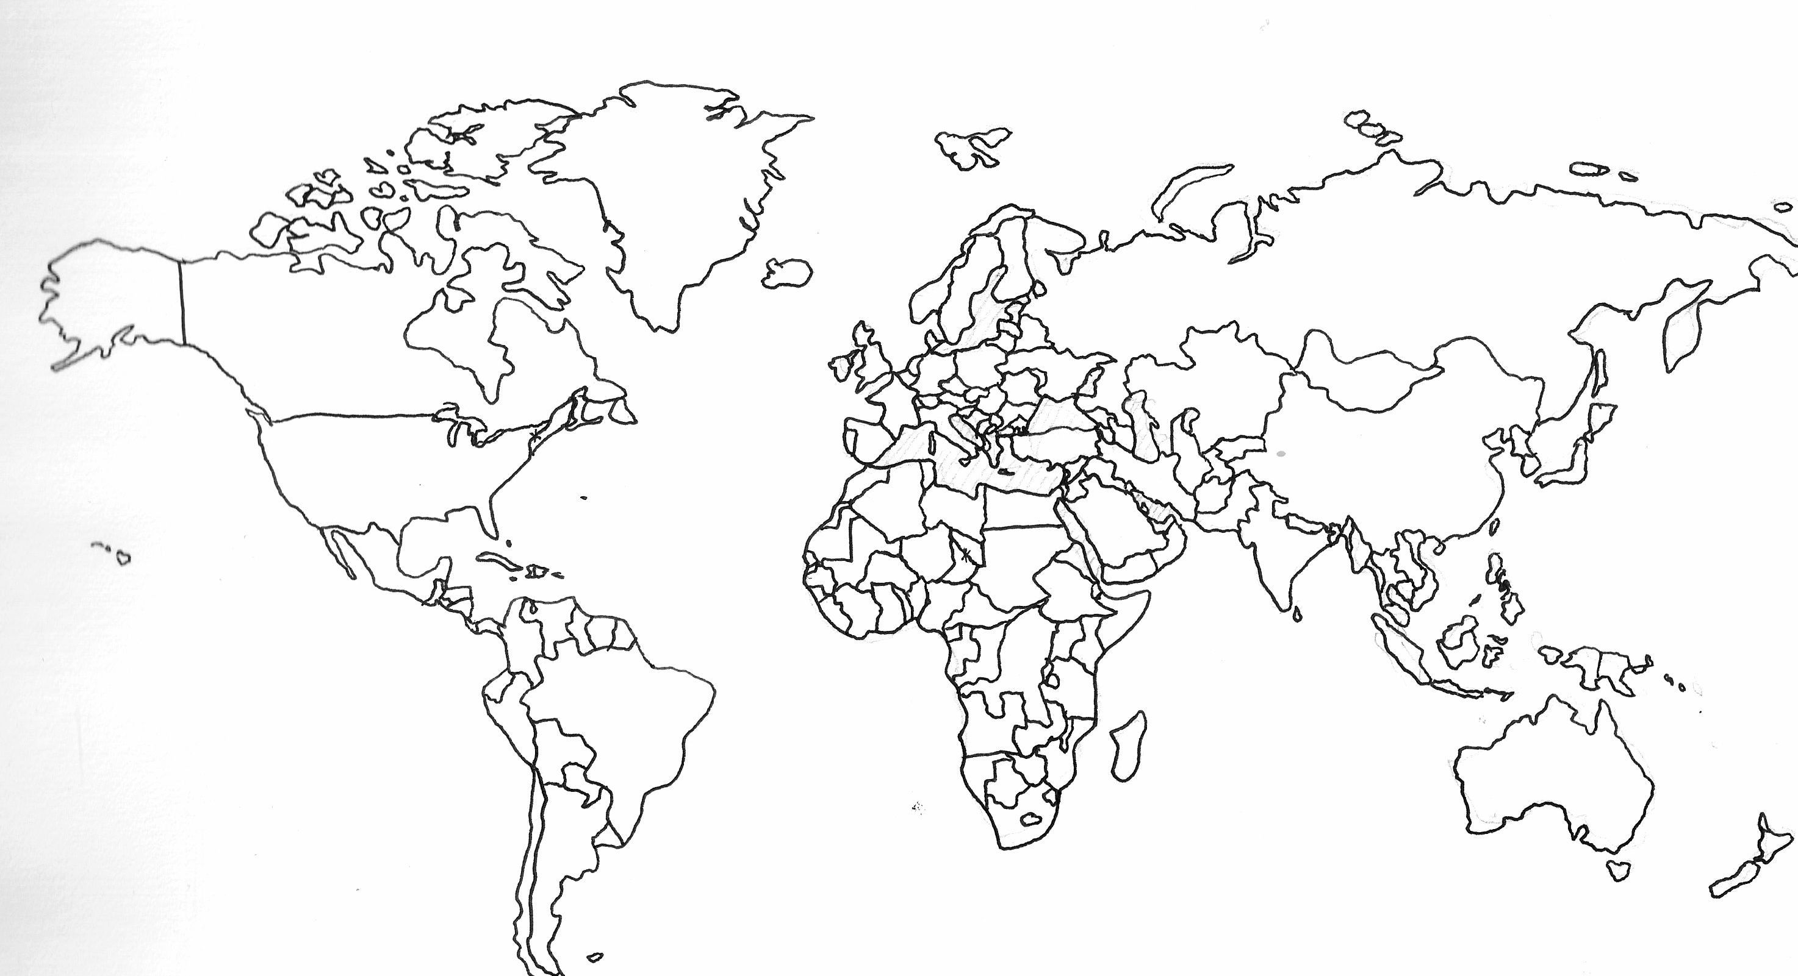
Where in the world do bananas grow?

Slide 17
Stage: 2 | Spelling Rules: The /l/ or /ul/ sound spelled ’-el’ at the end of words. This spelling is used after m, n, r, s, v, w and commonly s.
Spellings | 1st Attempt | 2nd Attempt | 3rd Attempt
tunnel
travel
towel
vowel
angel
banana
England
Scotland
Wales
Northern Ireland

Slide 18
t
r
a
v
e
l
Spelling Rules: The /l/ or /ul/ sound spelled ’-el’ at the end of words.
Can you create a wordsearch full of your spelling words?
tunnel
travel
towel
vowel
angel
banana
England
Scotland
Wales
Northern Ireland

